Slide 1
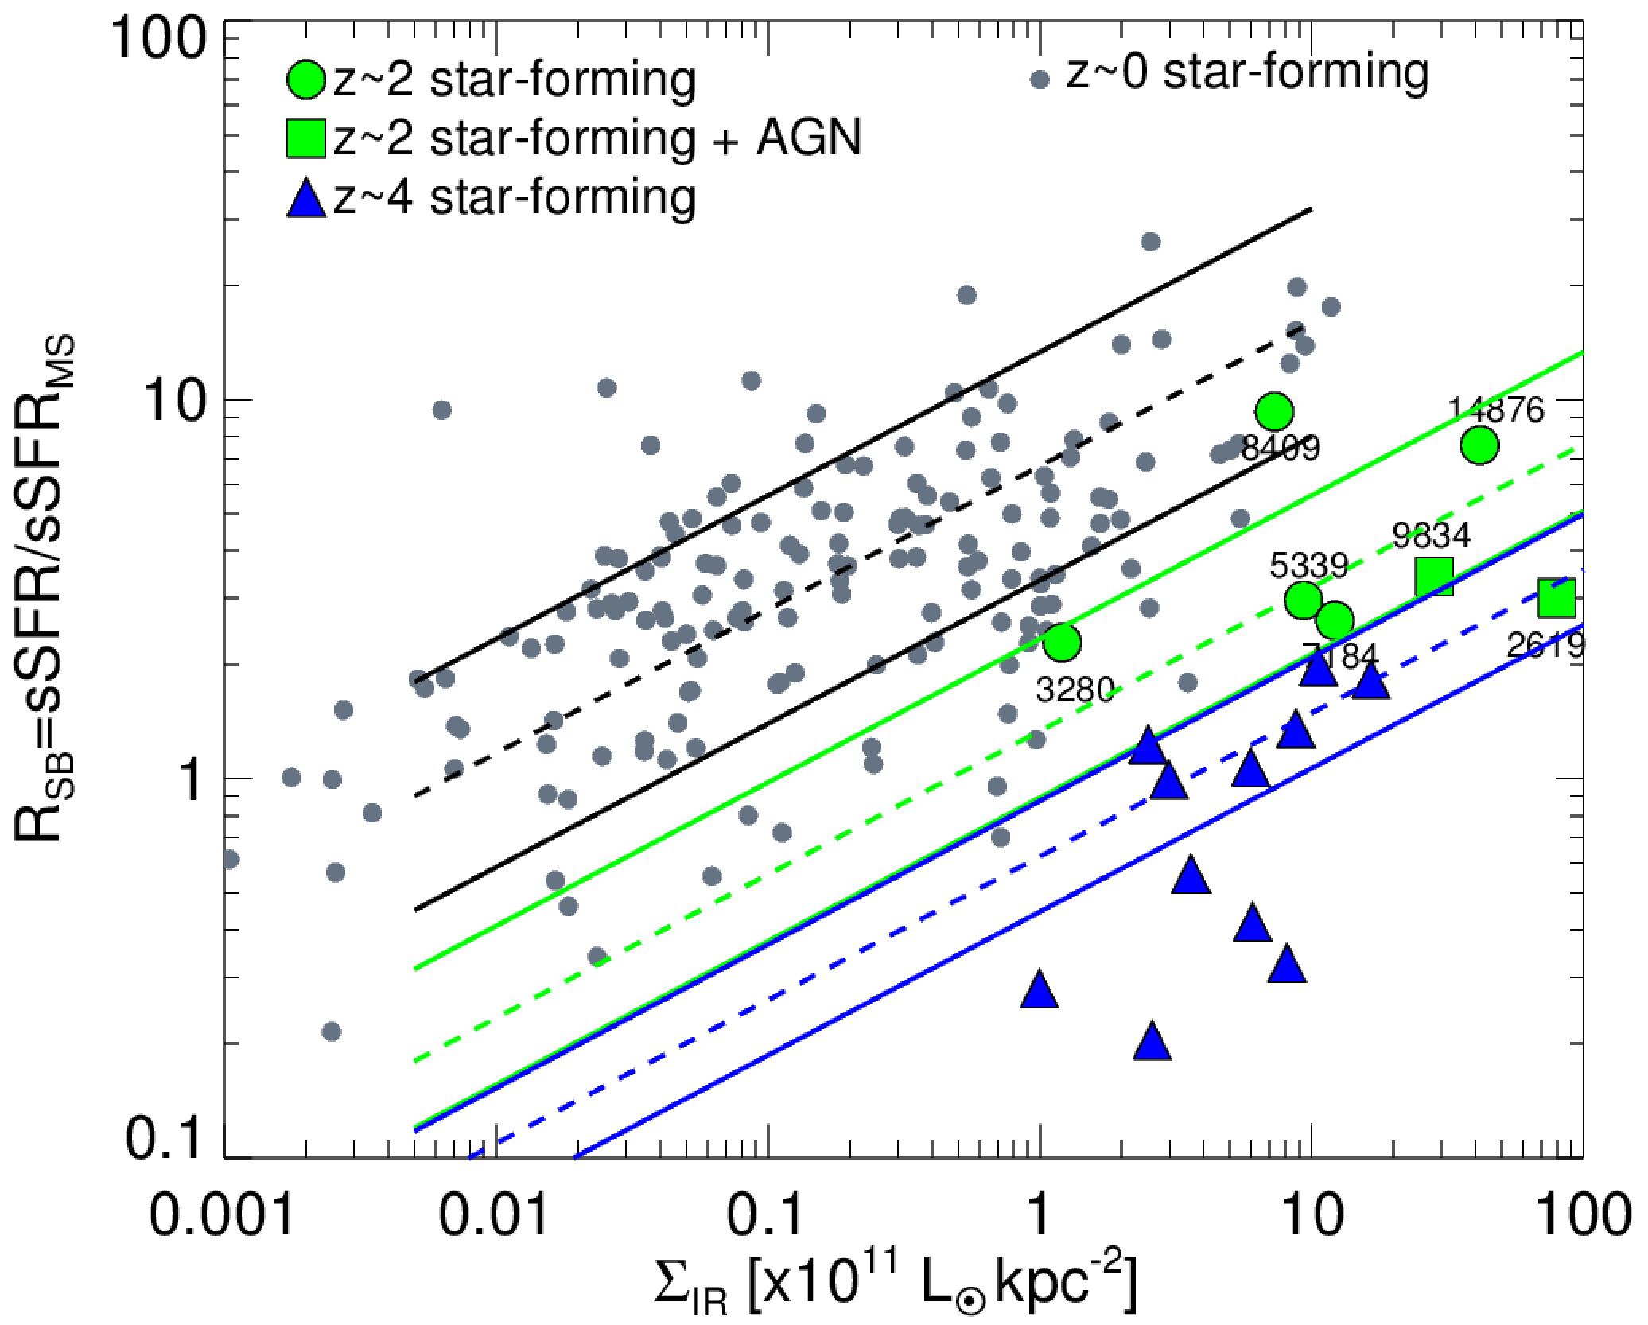
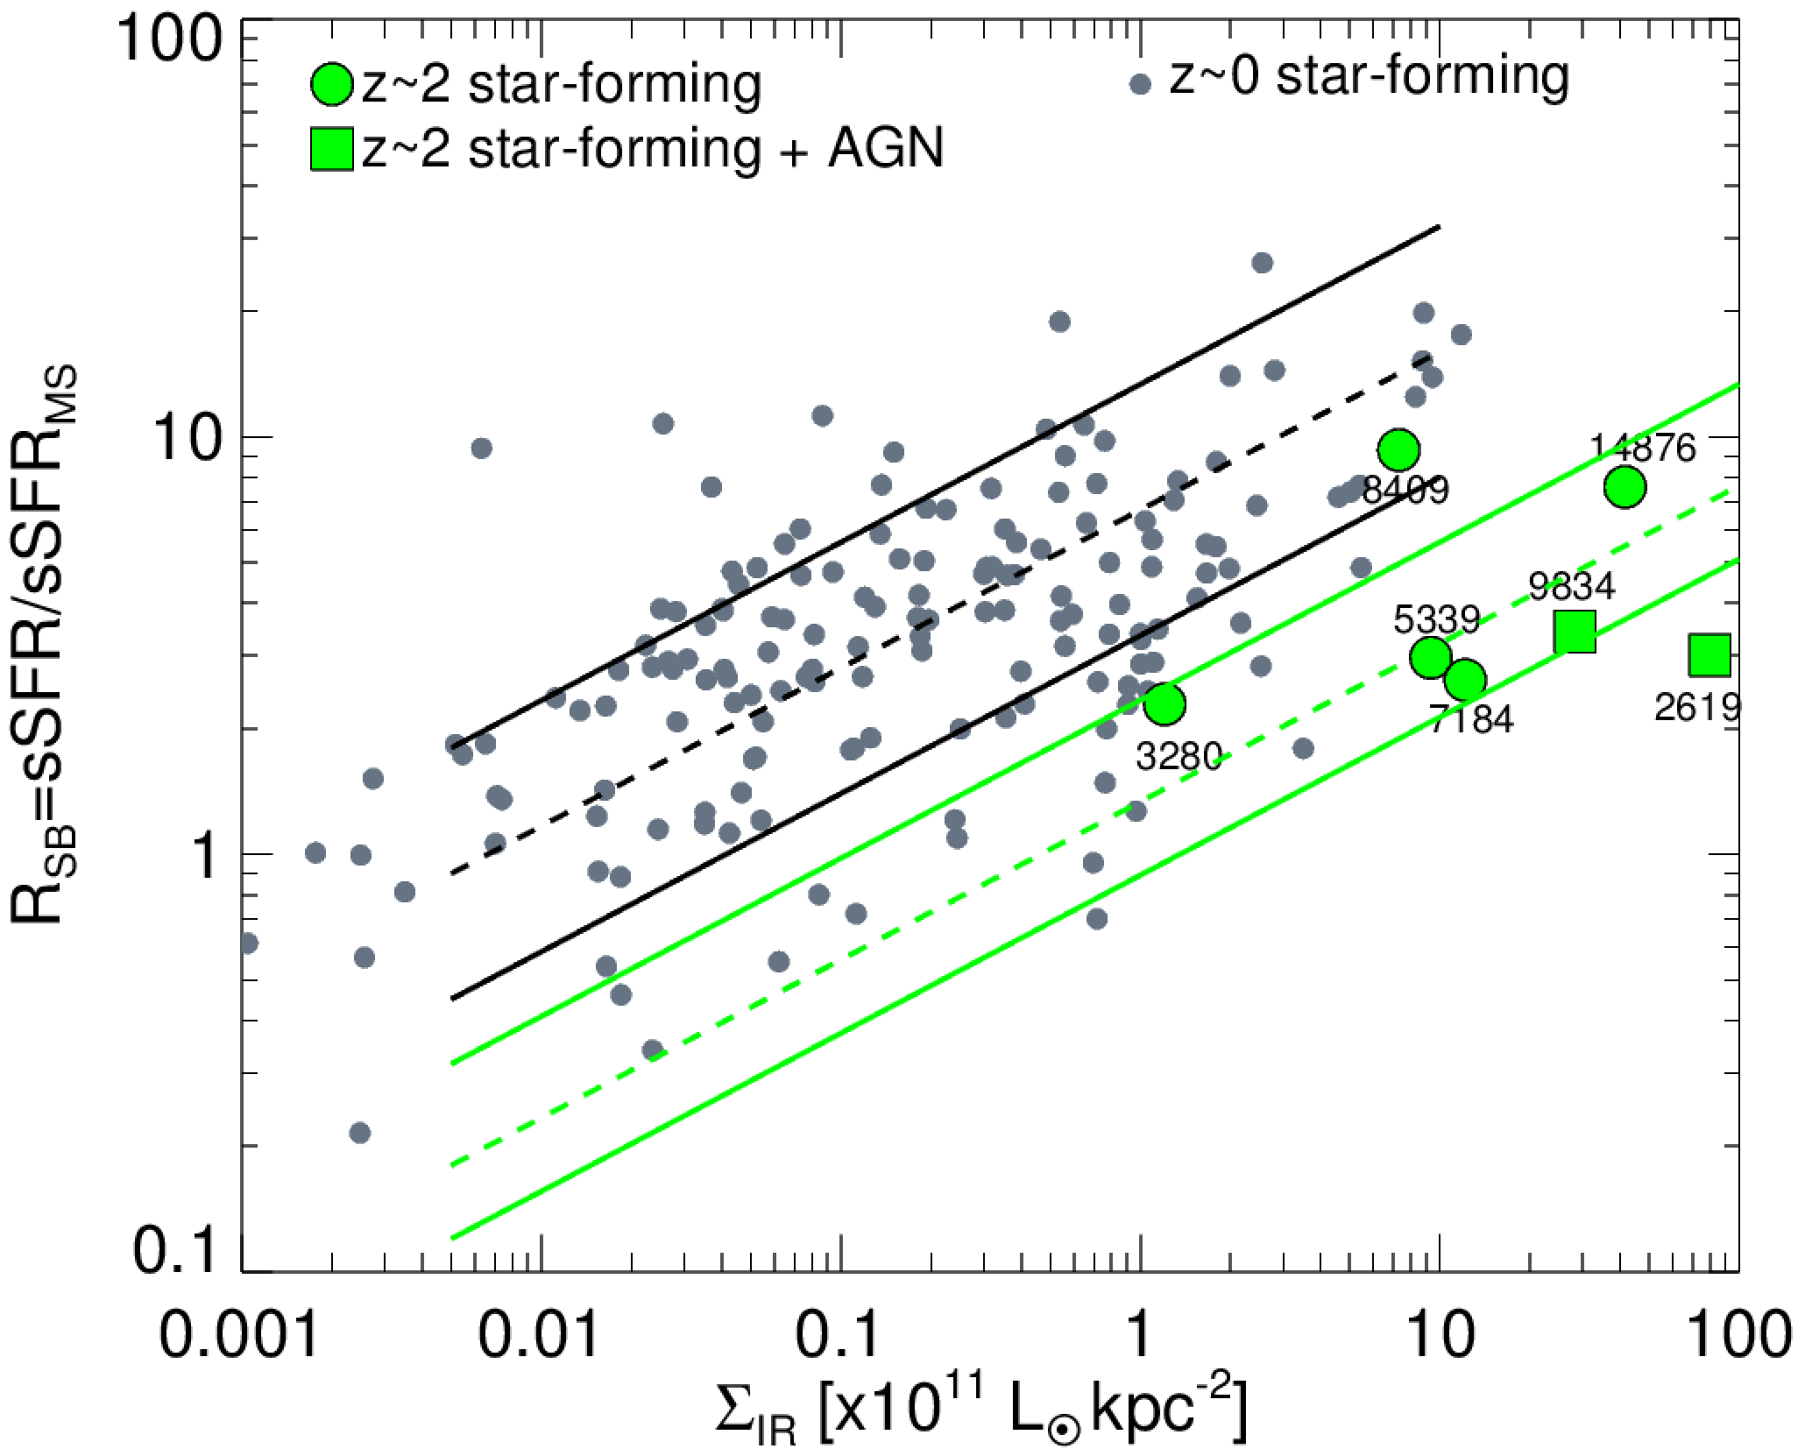
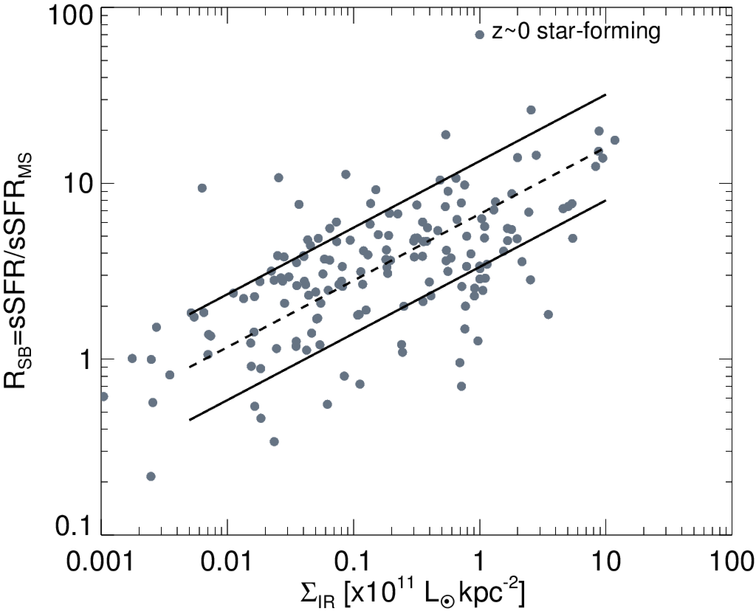
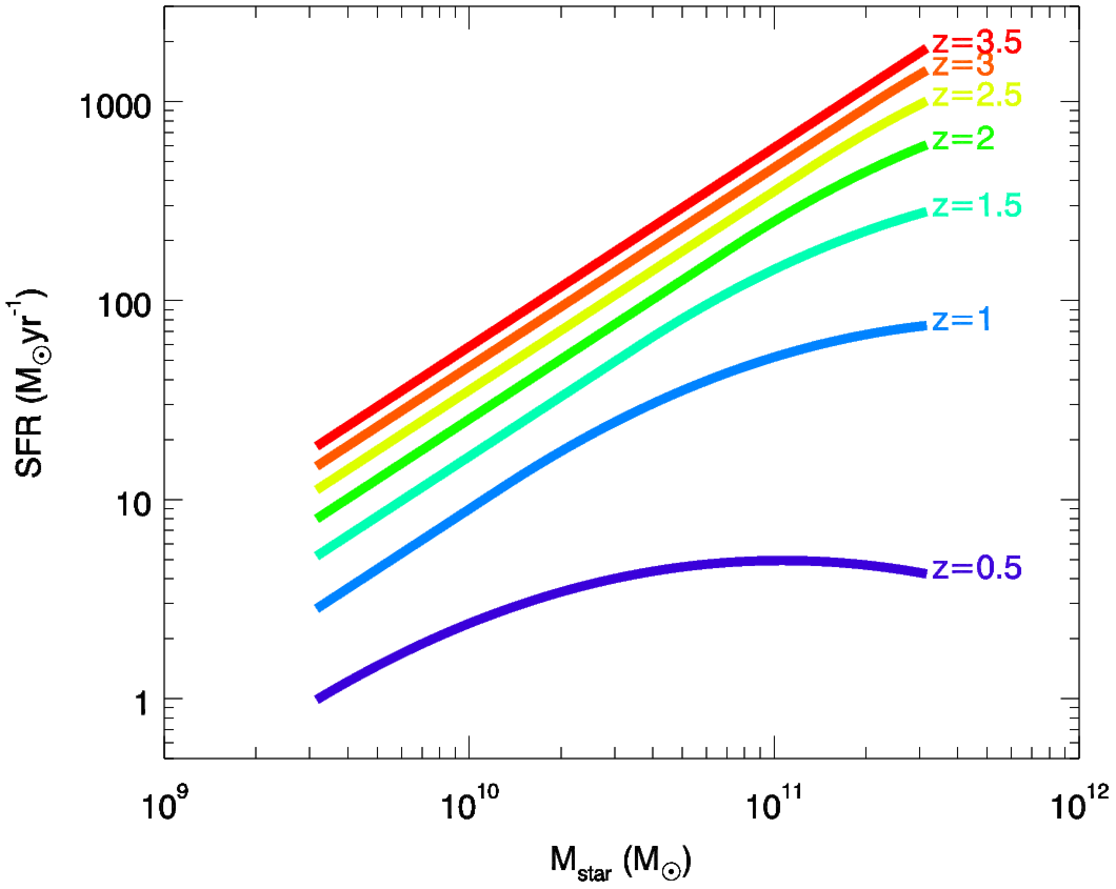
On star-formation compactness & bulges: the ALMA view
R_{SB}=sSFR/sSFR_{MS}
ALMA 870µm
0.2" resolution z~2
0.5-0.7" resolution z~4
Σ_{IR}(z~2) = Σ_{IR}(z~0) x 6
Σ_{IR}(z~4) = Σ_{IR}(z~0) x 12
Σ_{IR}(z) = Σ_{IR}(z~0) x (1+z)^{2.5}
vs Σ_{UV}(z) = Σ_{UV}(z~0) x (1+z)
SFR
τ<1Gyr
M★

Slide 2
Change of slope of the Main Sequence at high masses: effect of bulges ?
SFR
change of slope at high M★
M★
Schreiber +15
Change of slope of the MS: Whitaker +12, Magnelli +14, Schreiber +15, Lee +2015
Abramson +2014:
Suppression of SF efficiency with M★ = superficial due to bulge = portions of a galaxy not forming stars

Slide 3
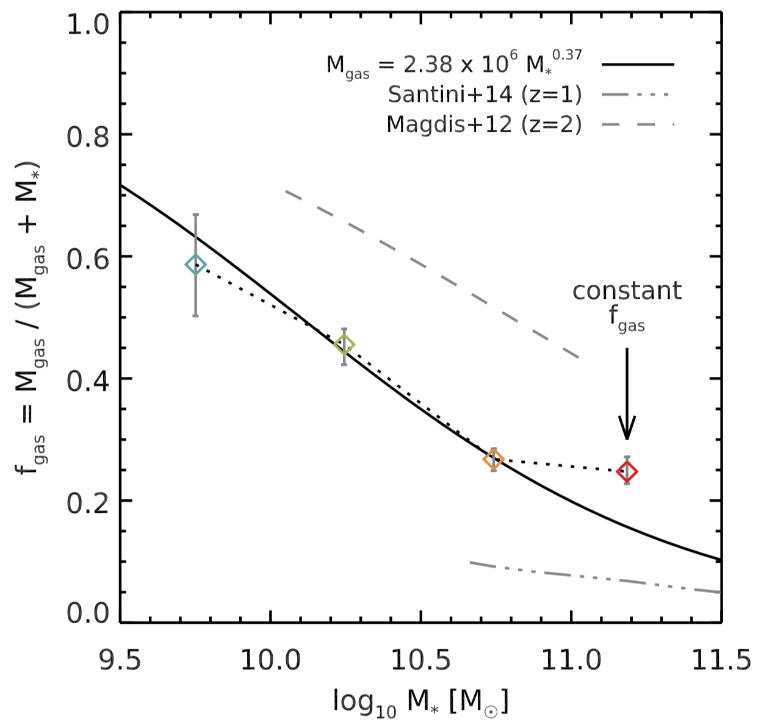
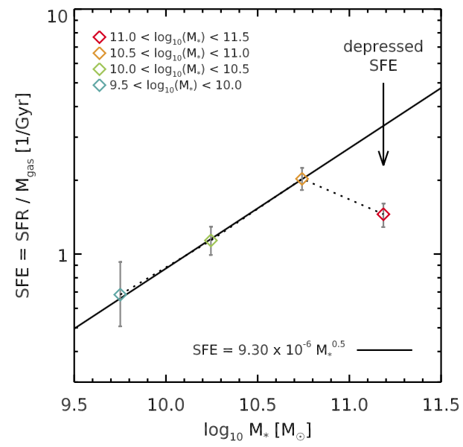
The drop in sSFR is due to a drop in SFE=SFR/Mgas It is not "superficially created by the bulge nor by gas fraction"
The drop in sSFR is due to a drop in SFE=SFR/Mgas It is not "superficially created by the bulge nor by gas fraction"
Schreiber, Elbaz, Pannella et al. (submitted)
SFE = SFR/M_{gas} [Gyr⁻¹]
fgas = M_{gas}/(M_{gas}+M★)
log(M★/M)=
9.5-10.0
log(M★/M)=
10.5-11.0
10.0-10.5
10.0-10.5
9.5-10.0
11.0-11.5
10.5-11.0
11.0-11.5
log(M★)
log(M★)

Slide 4
sSFR=SFR/M★
sSFR=SFR/M★
Main Sequence of
« blue » star-forming galaxies
Cloud of massive and
red dead galaxies
M★
M★

Slide 5
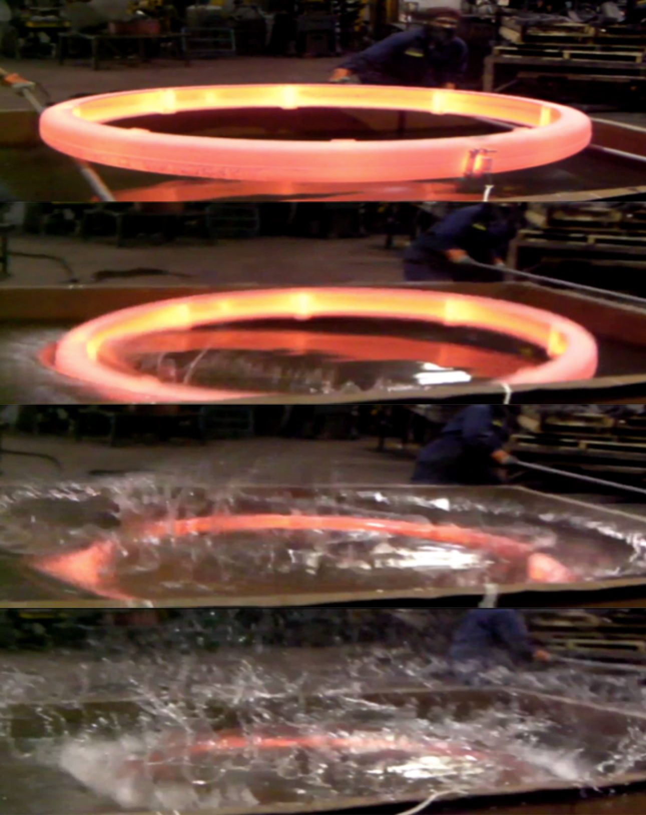
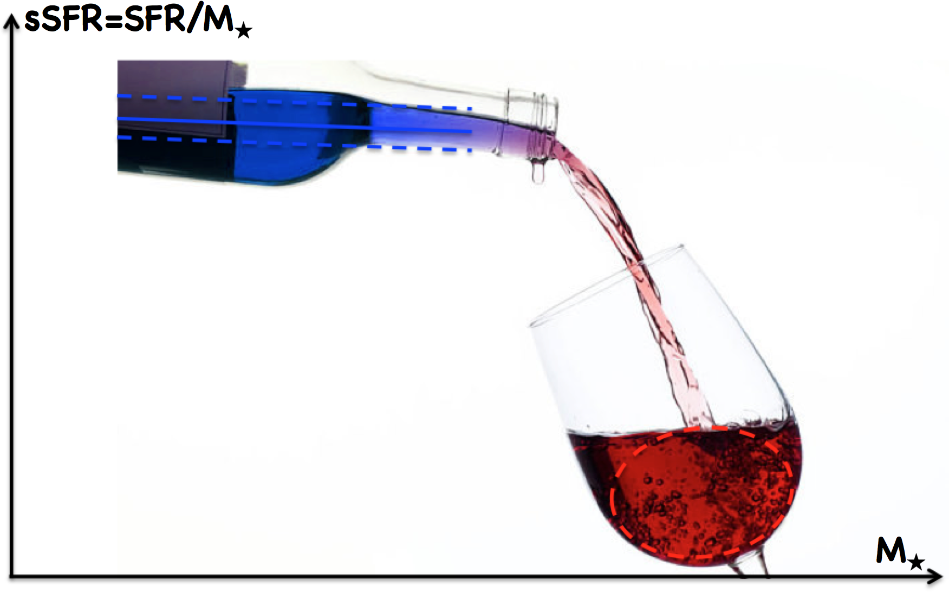
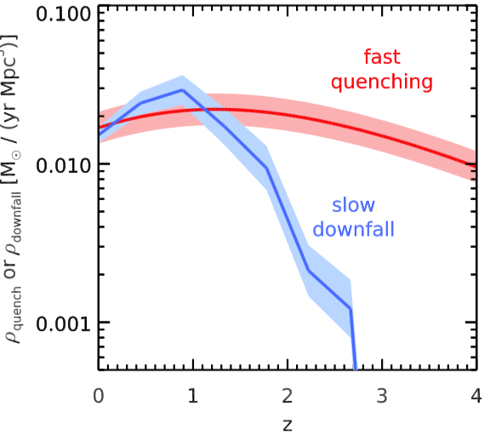
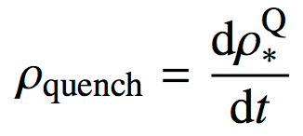
slow downfall rate= difference with no slope break
rapid quenching
slow downfall
stellar mass density Mpc⁻³ yr⁻¹
assuming that all the U V J quiescent galaxies were quenched by a fast process
where :
redshift

