Slide 1
Q1: Quenching and the cessation of star-formation
The "Q" word and its meaning
Is quenching a good word to describe the end of star-formation in galaxies ?
What are the timescale(s) for quenching? Pablo , Jarle
Is quenching due to starvation or gas expulsion? Romeel
What do we learn from the MS on the "Q" word ?
Is the apparent sSFR dichotomy real, and is it a fair statement that galaxies are either star-forming or quenched ?
Is quenching a one-way process or do quenched galaxies ever return to the Main Sequence?
Passive galaxies and the "Q" word
How many quenching pathways are there - one, two, many? Pablo
Do galaxies stay quenched because of internal or external factors? Romeel

Slide 2
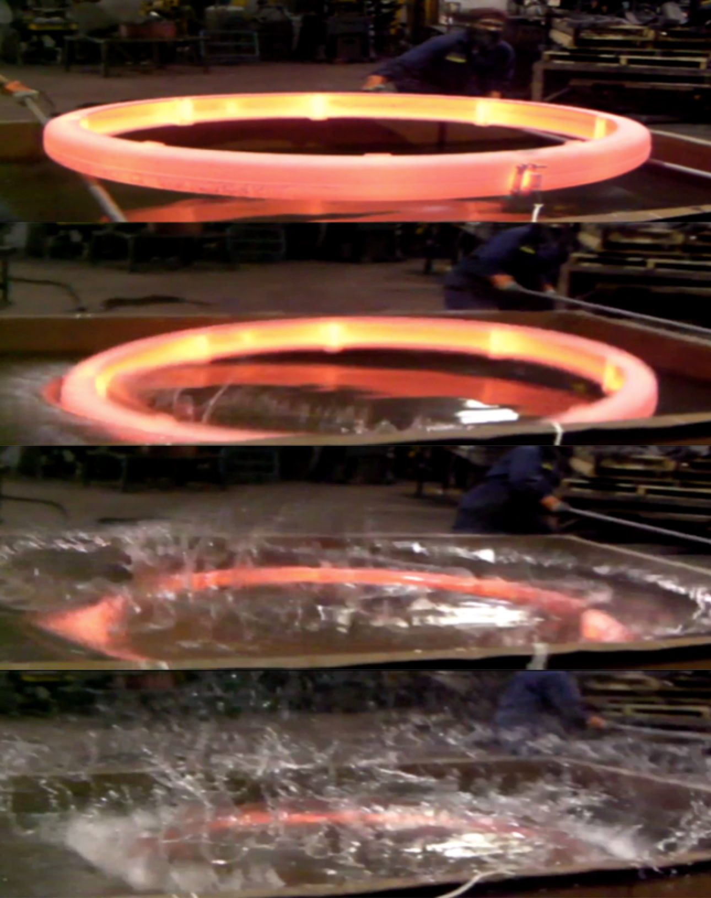
1. The "Q" word and its meaning
A. Is quenching a good word to describe the end of star-formation activity in galaxies ?
Robert Feldmann: « I will call quiescent galaxies quenched galaxies »
Françoise Combes: « I will call quenching any cessation of star-formation »
What is it that we are trying to understand here ?
Is it an issue or a well understood fact that comes
from a large amount of processes fast & slow ?
The McAllister view on quenching
Underlying old issues: aren’t we reformultaing the…
overcooling problem ?
formation of bulge problem ?
Is this issue only about gastrophysics ?
nature of dark matter ? (cold vs warm)
cosmological initial conditions (Planck >7Mpc)

Slide 3
1. The "Q" word and its meaning
A. Is quenching a good word to describe the end of star-formation activity in galaxies ?
Can we reject the possibility that passivity results from Mpc scale effects ? (cosmic rays, magnetic field, gravitational heating or other heating mechanisms, wrong treatment of the baryon density → the CMB scale stops at 7 Mpc-comoving…)
all MS galaxies above z=1.5 will end up with high Mg/Fe ratios and have a depletion time ~700 Myr → do we need a quenching mechanism ?

Slide 4
1. The "Q" word and its meaning
B. What are the timescale(s) for quenching? Pablo , Jarle
timescale for quenching should be relative to other timescales ?
other timescales: also confusing…
free-fall time ~ density^{-0.5} (which density ? Dense gas, molecular gas HI gas, stars, DM…)
depletion time (=1/SFE)= time to exhaust existing gas in galaxy (but HI vs H₂ and IGM)
dynamical time : wrt rotation if disk
cosmic time: what is a rapid timescale when the Universe was <1 Gyr ?
doubling M* time (=1/sSFR)
the timescale speaks about the mechanism:
violent quenching vs slow downfall of SF
need for quenching mechanisms or pure gas starvation ?
Notes:
gas depletion → Brinchman

Slide 5
1. The "Q" word and its meaning
C. Is quenching due to starvation or gas expulsion? Romeel
inside or outside process ?
starvation may be slow → see Peng, Maiolino & Cochrane 2015 Nature (4Gyr typically)
is energy the keyword for gas expulsion ? (AGN have enough energy but the coupling of this energy with gas remains to be proven)
observational constraints ?
jets in clusters → filling factor wrt IGM ?
mass loading factor : typically 1 observed by Genzel team (η=outflow/star-formation rate)
is it only a question of gas content or also SFE (hence gas density ?)
Finally is the key question « how to stop star formation » or « how to maintain star-formation ? »
gas refiled= Van den Bergh (1957)
SFR ~ gas density = Schmidt (1959)
If no external supply is available, the gaz in the solar vicinity will be exhauted about 700 million years from now

Slide 6
2. What do we learn from the MS on the "Q" word ?
A. Is the apparent sSFR dichotomy real, and is it a fair statement that galaxies are either star-forming or quenched ?
has the lower bound of the sSFR frontier (SF vs passive galaxies) been probed accurately ?
B. Is quenching a one-way process or do quenched galaxies ever return to the Main Sequence?
do we have any observational in favor or against rejuvenation of passive galaxies ?
quenching vs infall

Slide 7
3. Passive galaxies and the "Q" word
A. How many quenching pathways are there - one, two, many? Pablo
slow downfall vs rapid quenching
acceleration of star formation vs gas evacuation or both
external vs internal
B. Do galaxies stay quenched because of internal or external factors? Romeel
Peng, Maiolino Nature 2015 claim for a 4 Gyr timescale linked to starvation = internal cause on external matter
what prevents the mass returned by drying stars in a passive galaxy from forming new stars ? → SNIa ?,…
role of morphological quenching ?
cessation of infall: gravitational heating,

Slide 8
Open questions
link between quenching and bulge formation ? → Kormendy
can we separate morphological transformation from quenching ?
are mergers needs to loose angular momentum, concentrate stars, induce the large alpha-elements/Fe ratios ?
Is it true that compact stellar distributions imply quenching ?
faster gas consumption → need for supply ?
aren’t we actually debatting here the classical « overcooling issue » ? (M_{baryons}/M_{halo})
any implication on :
cosmology ? → CMB/Planck resolves only >7Mpc
dark matter nature ? → warm dark matter ?
is it true that winds are connected to quenching ?
role of mergers

