Slide 1
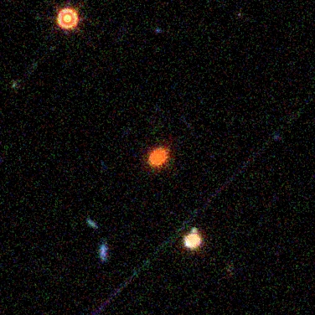
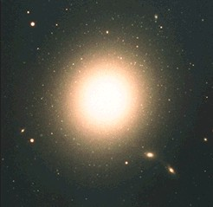
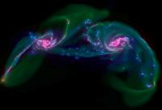
Quenching and the
cessation of star formation
Pablo G. Pérez-González
Universidad Complutense de Madrid UCM, Spain
Notes:
What we are learning within the SHARDS survey

Slide 2
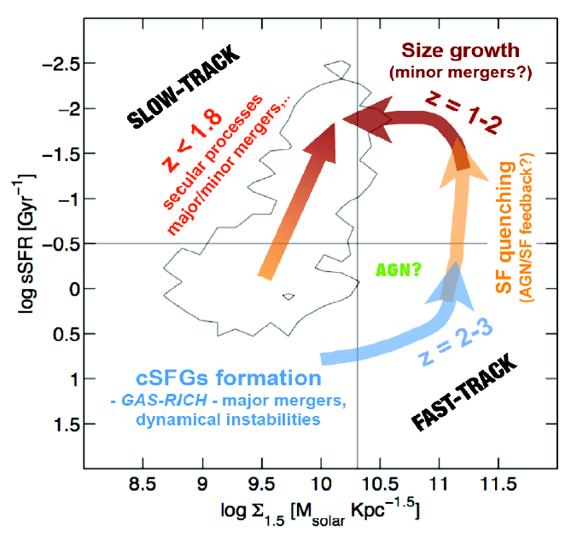
Pathways to quiescence in mass/SFR/size space
Barro, Faber, P-G+ (2013)
(die & small shrink)
SF suppression
Gyr
(shrink & die)
stellar mass ‘density’

Slide 3
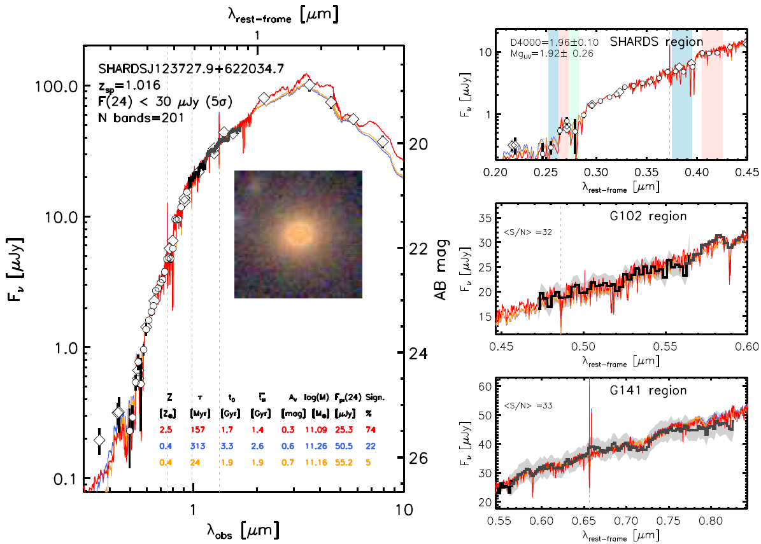
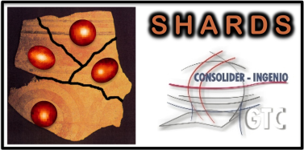
Timescales to arrive to quiescence for z>1 MQGs
D4000
Mg_{UV}
G102
Hβ
NaD
G141
D-S, P-G+ (2015, astro-ph/1507.07938)
TiO

Slide 4
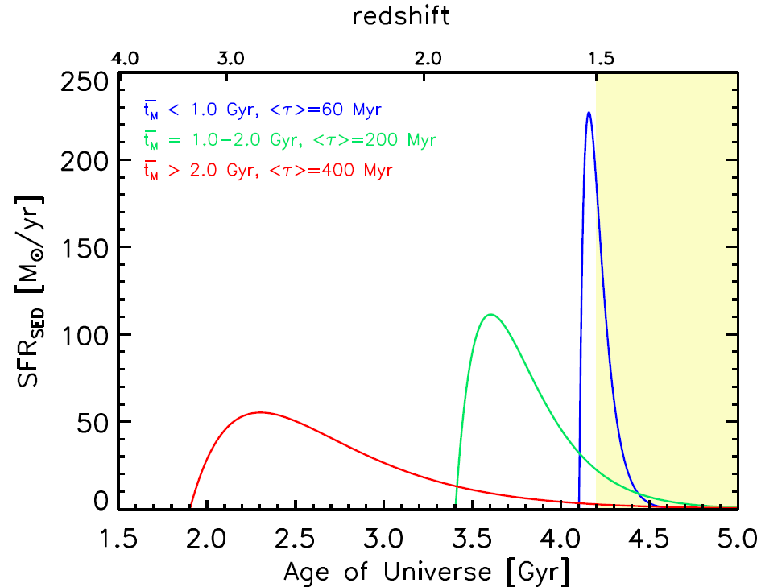
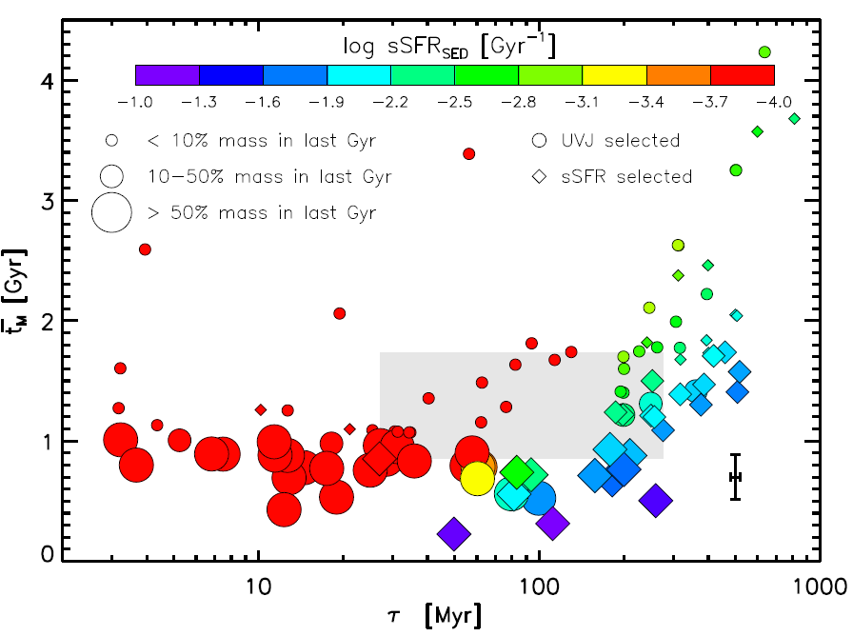
Duality (2 tracks) in population of 1.0<z<1.5 MQGs
Mature
Interm
Senior
Senior
Mass-weighted age
Intermediate
Mature
D-S, P-G+ (2015, astro-ph/1507.07938)
timescale

Slide 5
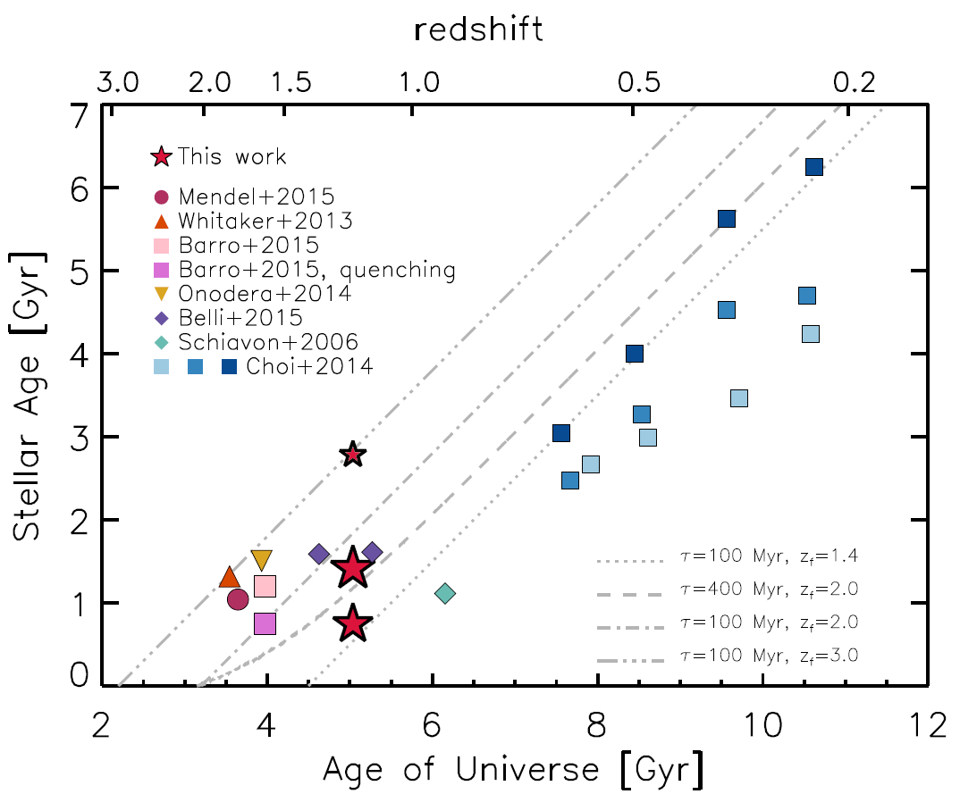
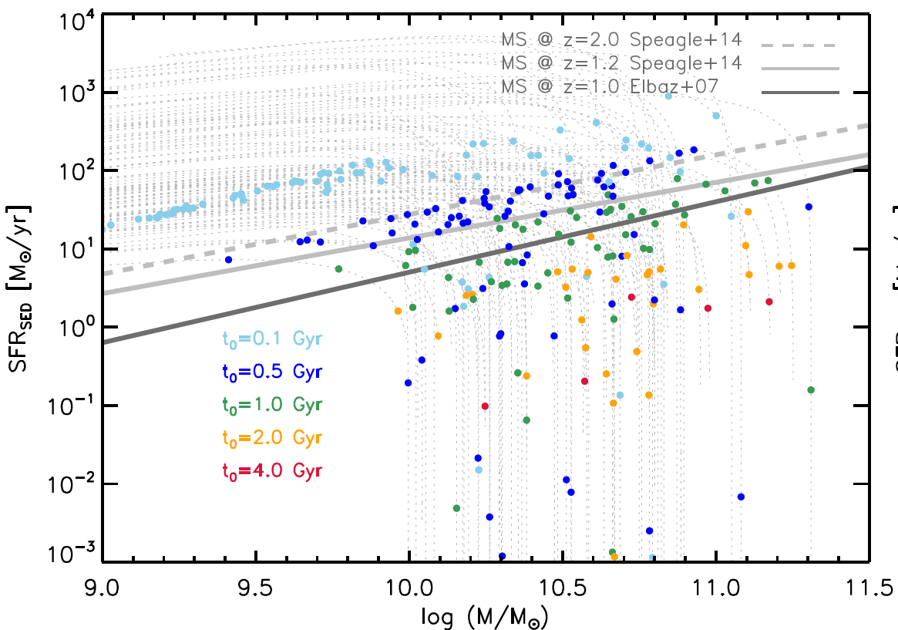
Time on the MS and rejuvenation
Senior
D-S, P-G+ (2015, astro-ph/1507.07938)
Mature
D-S, P-G+ (2015, astro-ph/1507.07938)
D-S, P-G+ (2015, astro-ph/1507.07938)

Slide 6
