Slide 1
ISM in galaxies
black hole accretion (AGN) & star formation (SF)
20x increase from z = 0 to 2 !
gas critical : due to ??
more gas (initial supply or accretion)
or
higher efficiency gas ➔ stars , AGN
starbursts – merging ?
also morphological driver

Slide 2
SF regulated by inflow, outflow, or HI ➔ H₂ conversion ?
scales of "stellar feedback” ?
SF differences at low and high redshift?
accretion and ISM properties vary with space and time?
physical understanding

Slide 3
properties of SF gas at low z
H₂ : Milky Way, local galaxies and starbursts/ULIRGs properties/structure of H₂ clouds thresholds in gas – to form H₂ , to form *’s
SF laws -- two modes of SF ? quiescent & dynamically driven SF ?

Slide 4
estimating H2 masses – for resolved clouds M_{vir} correlated with L_{CO} (= area T_{CO} Δv)
How can an optically thick CO line measure mass ??

Slide 5
measuring ISM
CO emission collisional excitation by H₂ well-calibrated correlation of
M_{H2} w/ CO 1-0 luminosity
M_{vir} / L_{CO} varies as :
< n^{1/2} / T_{k} >

Slide 6
GMCs
N(M) α M^{-1.6}
<M> ~ few x 10⁵ M , D ~ 40 pc <n> ~300 H₂ cm⁻³ self-gravitating but irregular morphology
P_{turb} ~ 100 x P_{ISM} long-lived

Slide 7
SFR from L_{IR}
assume all L from young *’s absorbed
how long *’s are embedded –
SFR (M /yr)= 1.2 – 2 x 10⁻¹⁰ L_{IR} / L
use 2x10⁻¹⁰

Slide 8
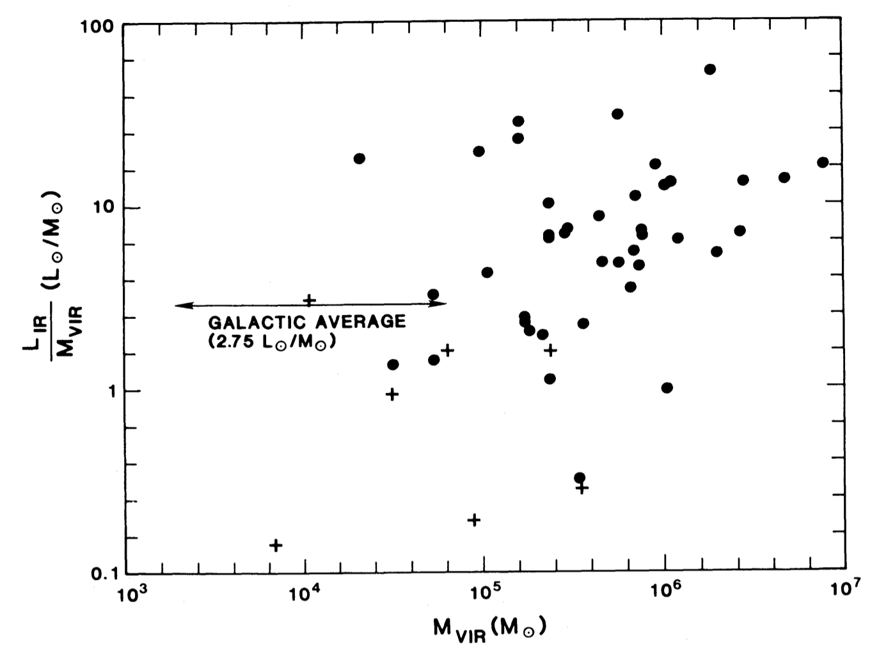
Galactic GMCs : SF vs M_{H2}
L_{IR} / M_{vir}
Gal. Ave.
4 L/M
M_{vir}
Gal. Ave. 4 L/M ➔ τ_{ism➔*} ~ 1.2x10⁹ yrs
2% eff. on a free-fall time
accretion needed !!
Scoville & Good 89

Slide 9
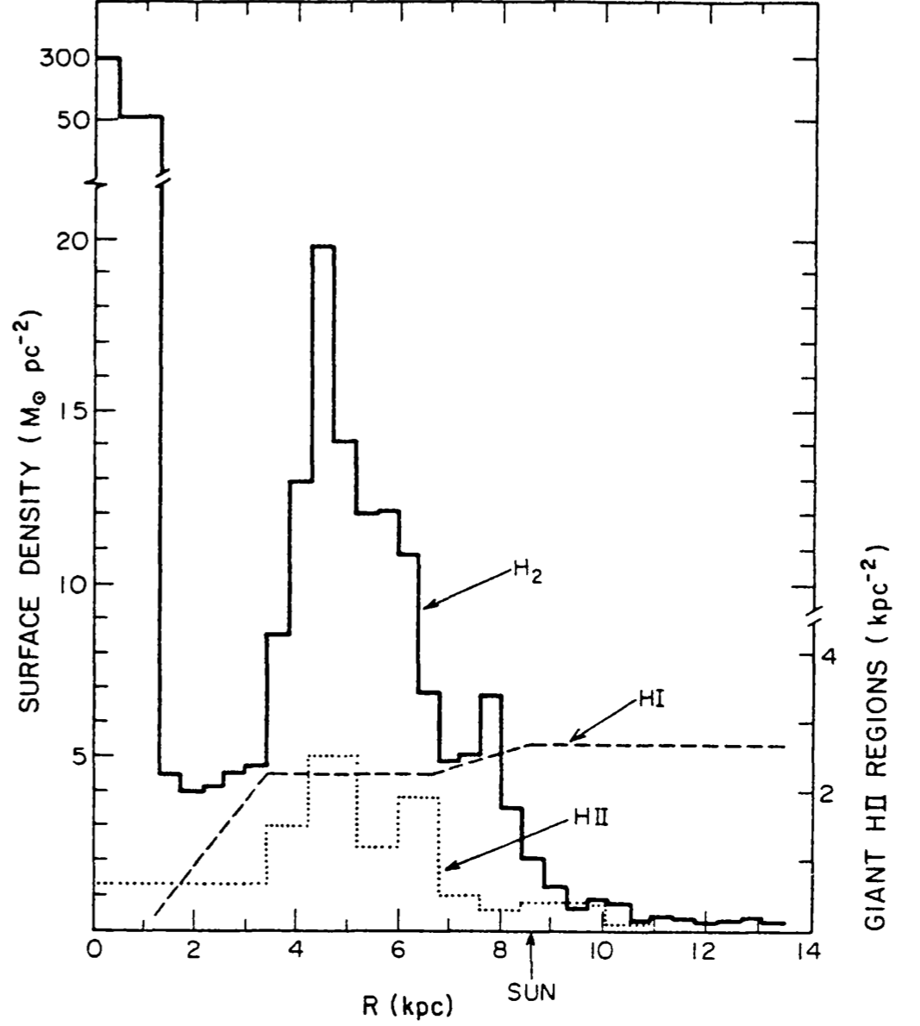
Milky Way ISM radial distributions (~ spirals)
summary :
HI flat (~10²¹ cm⁻² )
excess gas ➔ H₂
H₂
HI
HII

Slide 10
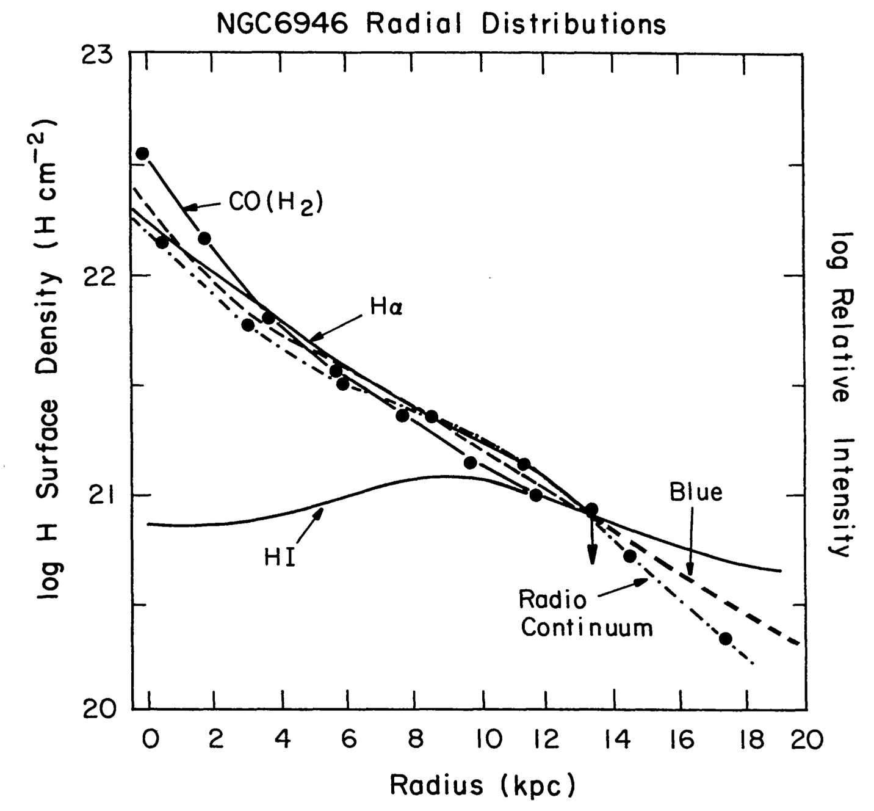

Slide 11
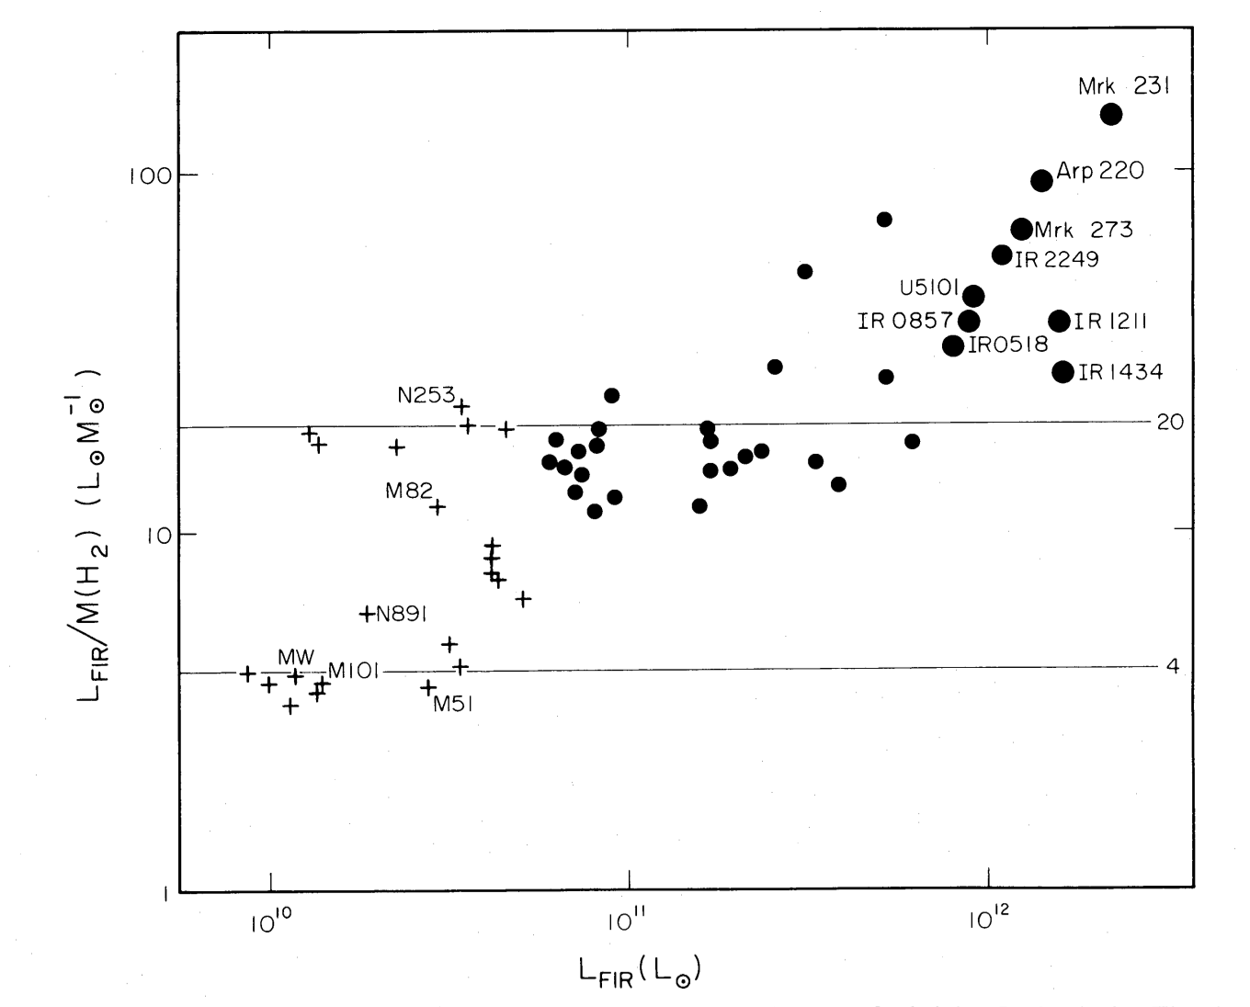
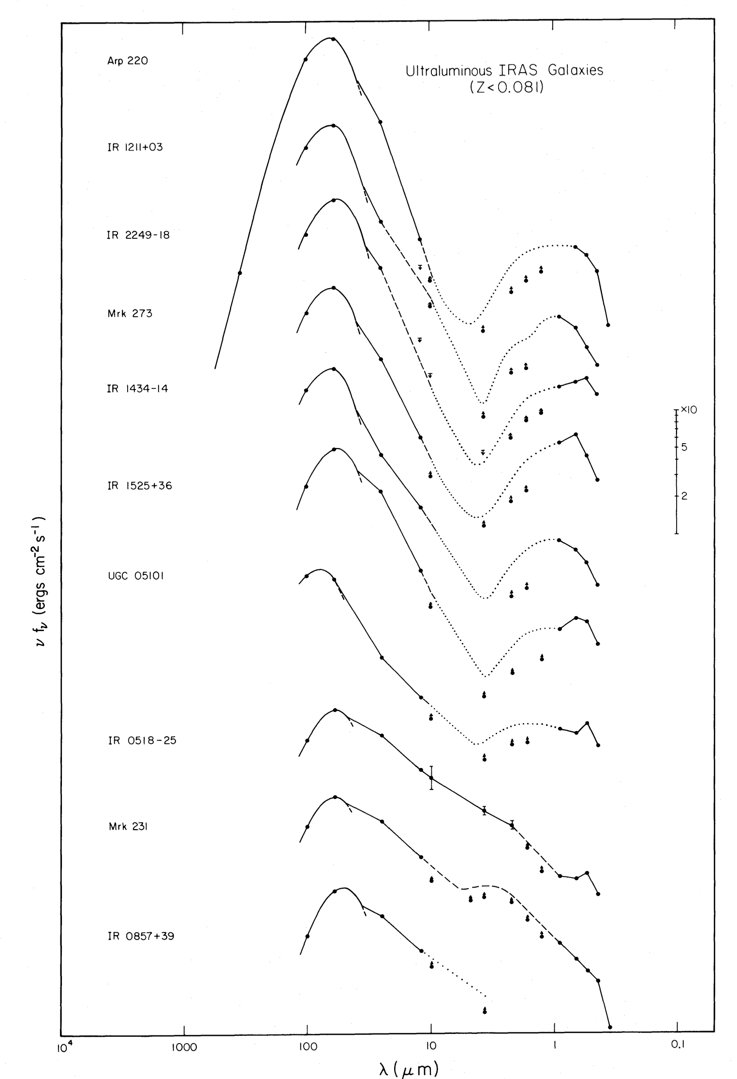
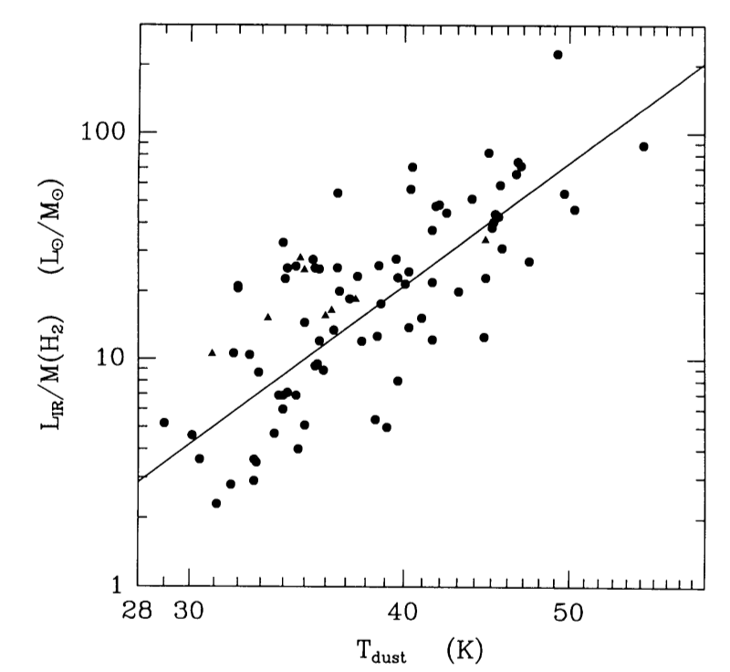
Observed SEDs
Low-z ULIRGs Sanders etal 88 L_{IR} / M_{H2}

Slide 12
2 modes of star formation :
quiescent SF -- slow / inefficient (~2% per f-f time)
< τ_{dep.} > ~ M_{gas}/SFR ~ 3x10⁹/3M⁄ yr⁻¹ ~ 1 Gyr for MW
starbursts -- dynamically triggered & have a max. rate !
τ_{SF} < 0.1 < τ_{dep.} > ~ 100 Myr
e.g. ULIRGs & spiral arms vs interarms

Slide 13
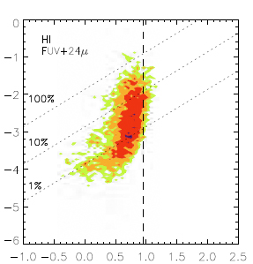
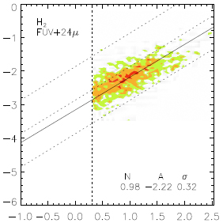
w/i galaxies: H₂ has clearer relationship to SF
HI
H₂
log SFR Surface Density
log SFR Surface Density
log HI Surface Density
log H2 Surface Density
Bigiel etal 08
little H₂ data in outer disks where HI dominates

Slide 14
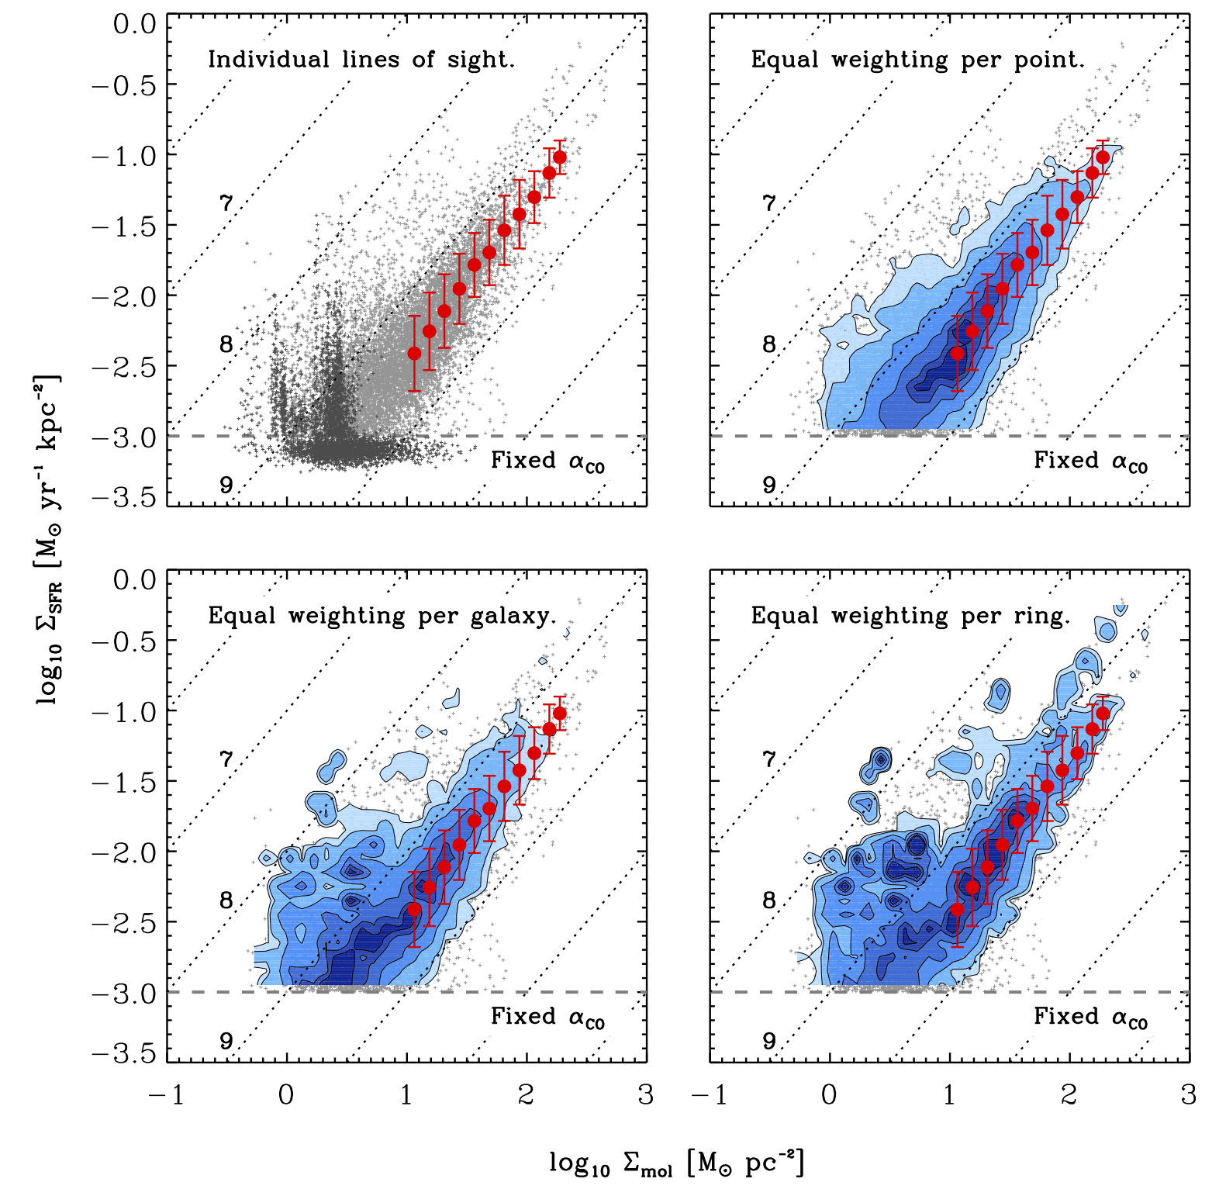
Leroy etal 2013 30 local disk galaxies
➔ SFR α M_{mol} i.e linear SFR law

Slide 15
lessons from low z
HI saturates at ~ 10²¹ , extra Σ ➔ H₂
H₂ gas – self-grav. , not pressure eq.
➔ hard to change SFR , hard to disrupt
H₂ long lived (> 100 Myr) , but turb. energy ??
but SFE can be changed (spiral arms, mergers)
dynamics ➔ compression @ > 5-10 km/s
➔ SF w/ 2 modes : quiescent (linear w/ H₂)
dynamically driven
accretion required ⬅ few M yr⁻¹ for MW

Slide 16
highz galaxies -- 3 populations :
quiescent (red) galaxies
star forming galaxies (main sequence)
starbursts
star forming galaxies evolve with z
Rodighiero ‘11, Sargent etal ‘12
need to measure ISM contents

Slide 17
High z Gas :
CO (mostly higher J) , CII (158 μm) reviews : Solomon & Vanden Bout ’05
Carilli & Walter 2014 early detections : QSO’s, lensed sources, SMGs later : many individual objects surveys – PHIBBS (Tacconi, Genzel, Combes ...)
SMGs – Ivison, Blain, Smail ..
GN20 – Daddi & Hodge ... very high z – Walter Riechers Carilli Wang ...

Slide 18
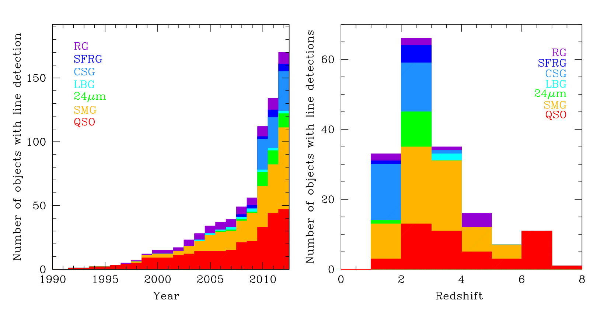
cumulative molecular line detections at high z
(pre-ALMA - Carilli & Walter ’14 )

Slide 19
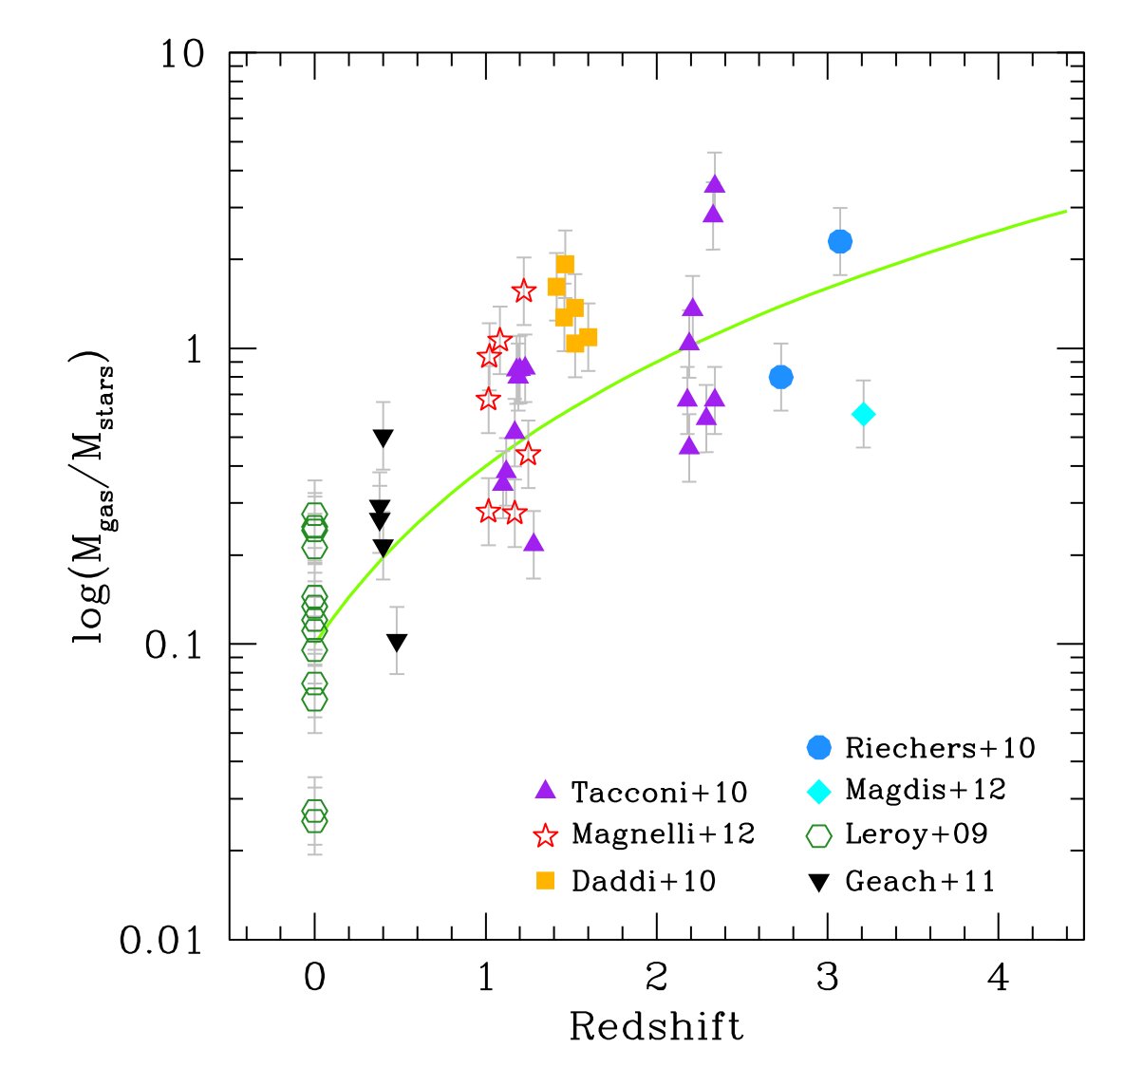
gas contents from CO

Slide 20
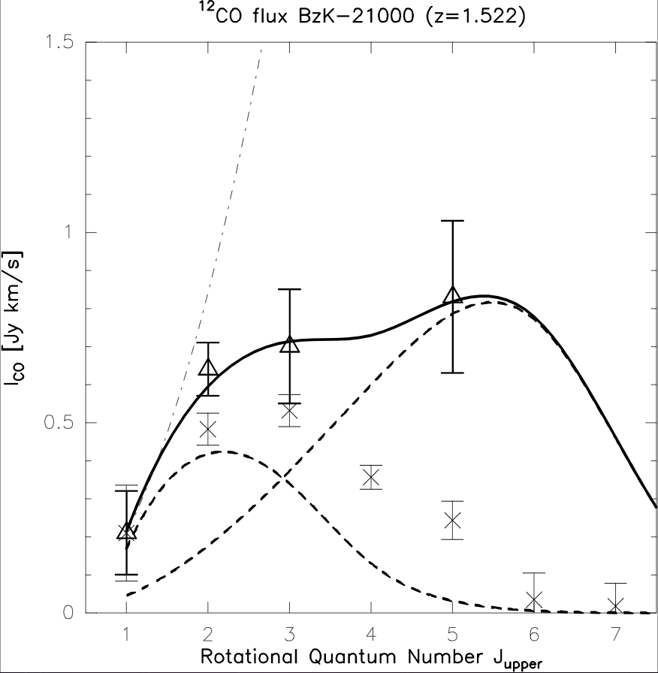
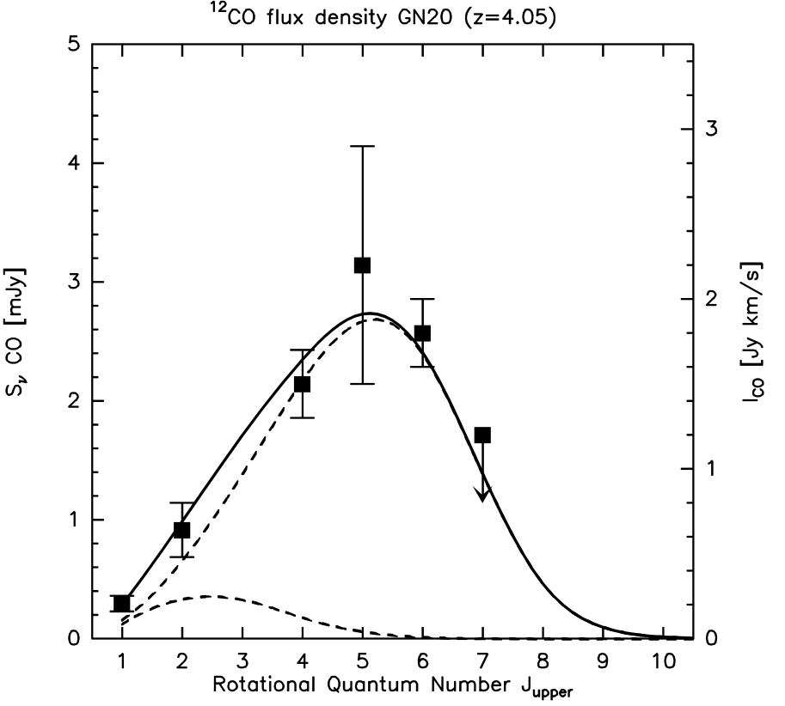
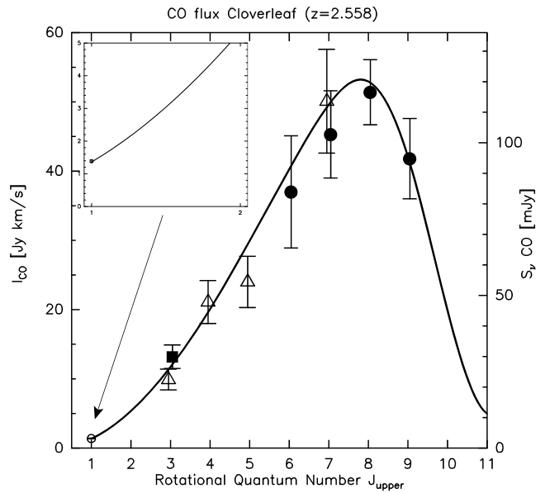
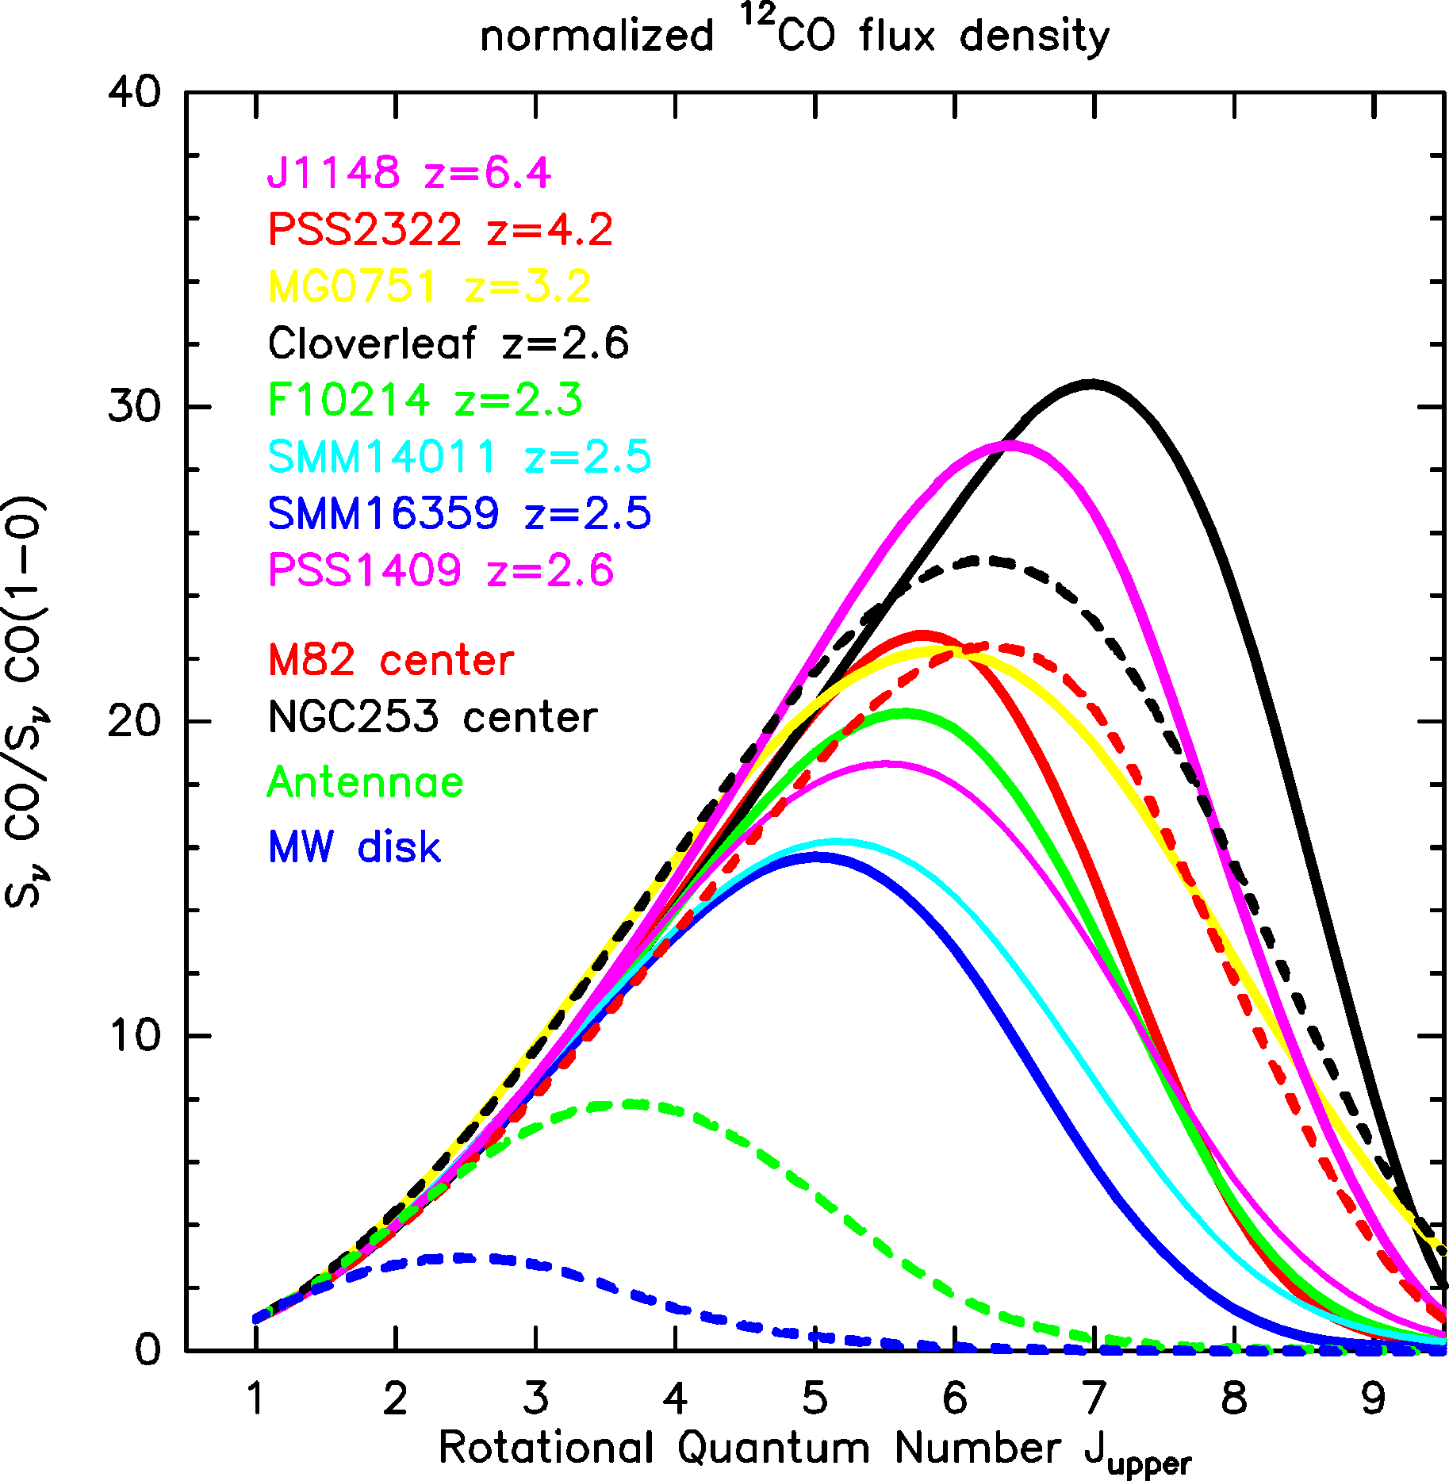
wide range of excitation in high z galaxies
z=1.5 SFG Milky Way
z=4.0 SMG
z=2.6 QSO
CO Excitation Line Ladders:
low, “Milky-Way-like” CO excitation
T_{kin} ~ 10-20K , n_{gas} ~ 300 cm⁻³ (GMCs)
(2) high, “ULIRG-like” CO excitation
T_{kin} ~ 40-60K , n_{gas} ~ 3x10⁴ cm⁻³
Milky Way
Riechers etal ‘6, ‘9, ‘11, Weiss etal ‘7 Dannerbauer etal ‘9, Carilli etal ‘10
Notes:
Dannerbauer, Daddi, DR ea. 2009

Slide 21
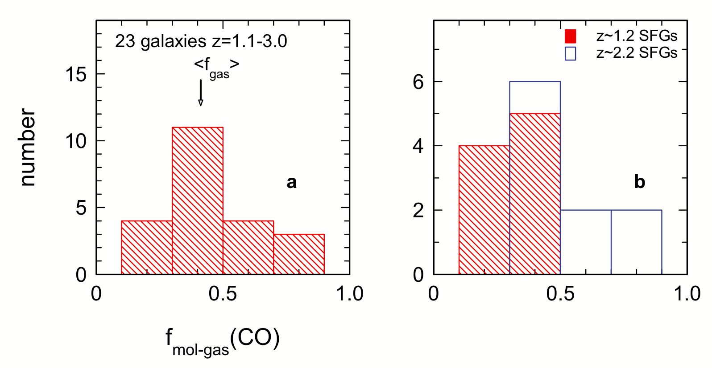
H₂ contents at z ~2
Tacconi etal 2010 – sample of 23 massive spirals @ z = 1-3
(not IR or SF selected)
34%
44%
f_{gas} = M_{H2} / (M_{H2} + M* )

Slide 22
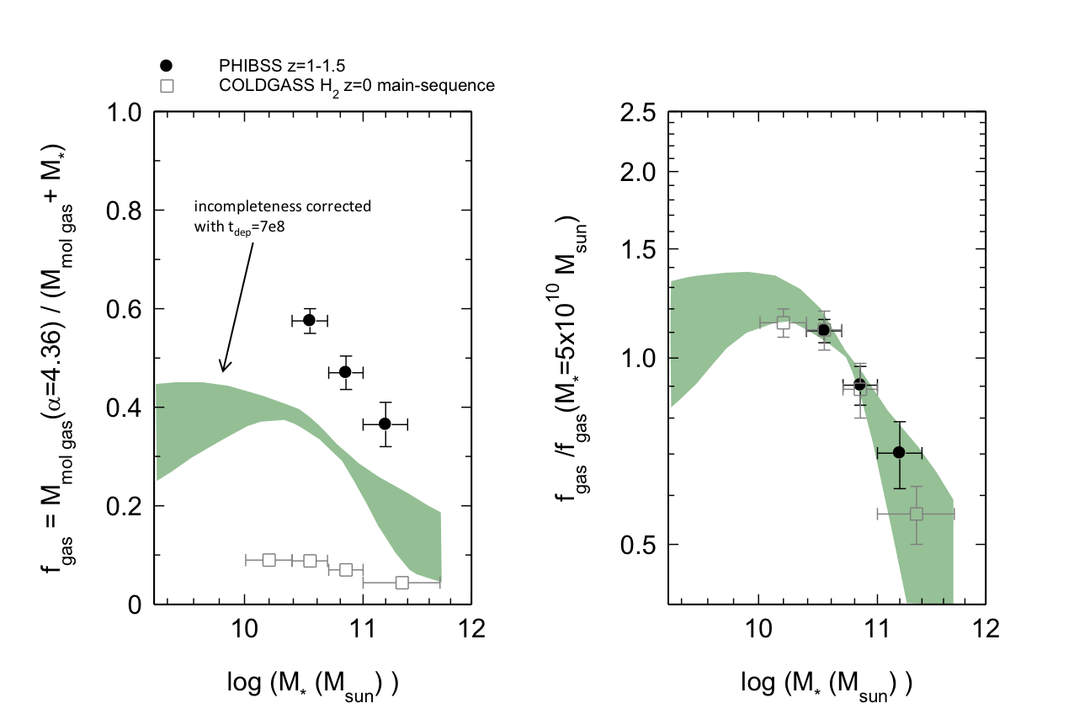
Tacconi etal 2013
Genzel 2015 – M_{mol}/ M* α M*^{-0.4} and (1+z)³
depletion time indep. of M*
t_{dep} varies (1+z)^{-0.3} x (sSFR/sSFR(ms,z,M*))^{-0.5}

Slide 23
CII 158 μm line
a primary cooling transition for atomic gas
➔ very bright and easily detected
CI ionization – 11.3 ev
fine structure line w/ A ~ A_{CO} ₁₋₀
➔ low critical density
excellent for redshifts and dynamics studies
not so clear how to use fluxes

Slide 24
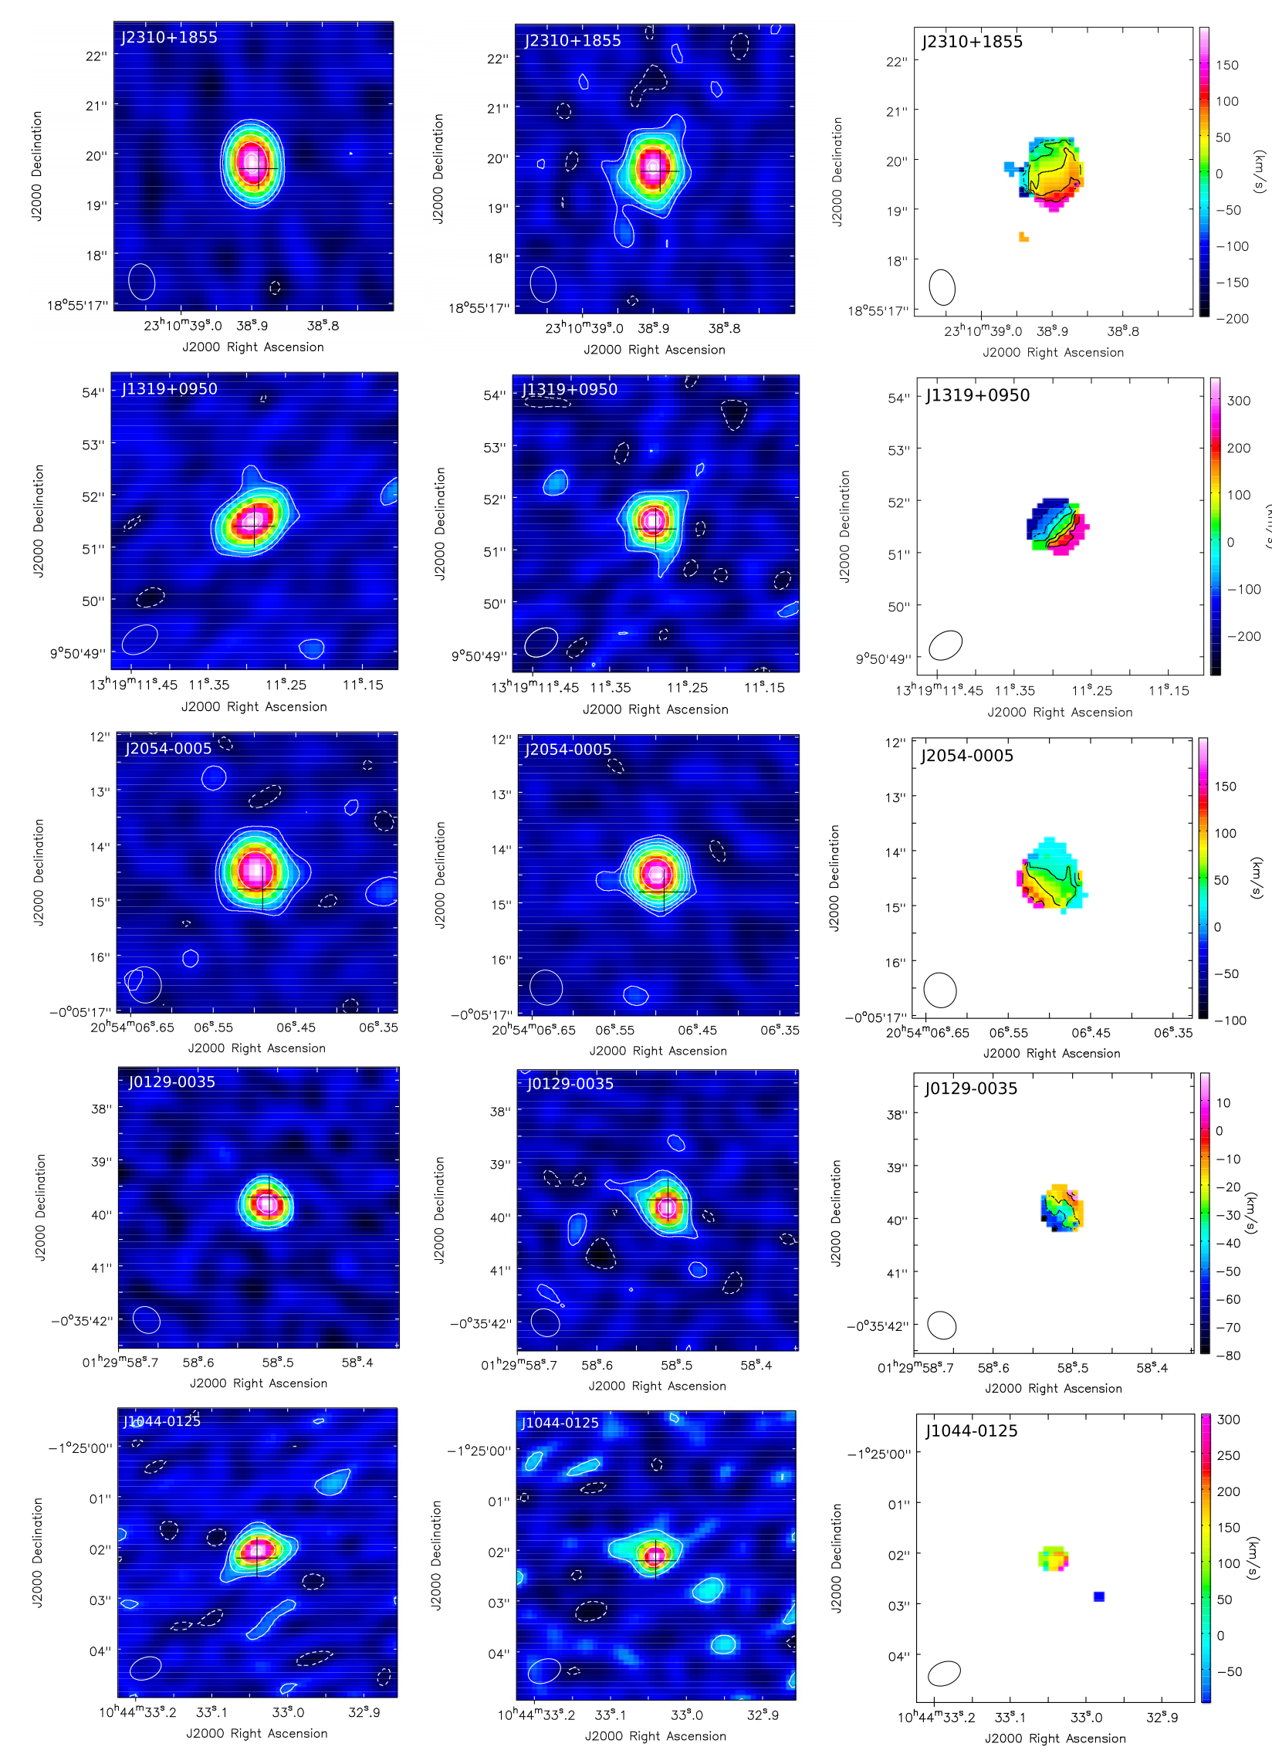
e.g. Wang etal 2013
ALMA cyc 0
6 z = 6 QSOs
dust cont.
CII
V_{CII}
➔ M_{dyn} = 10^{10 – 11} M

Slide 25
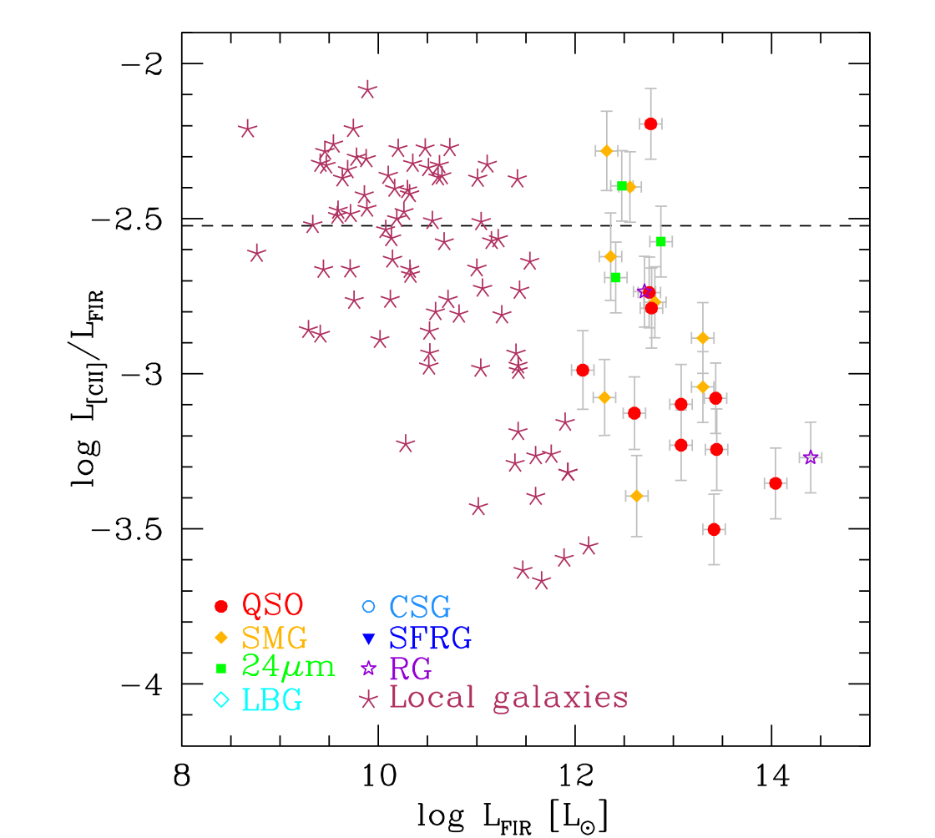
can CII be used as SFR tracer ?

Slide 26
evolution due to
more gas (initial supply or accretion)
or
higher efficiency gas ➔ stars , AGN
starbursts – merging ?
variation w/ stellar mass evolution w/ time
Rodighiero ‘11, Sargent etal ‘12
need to measure ISM contents

Slide 27
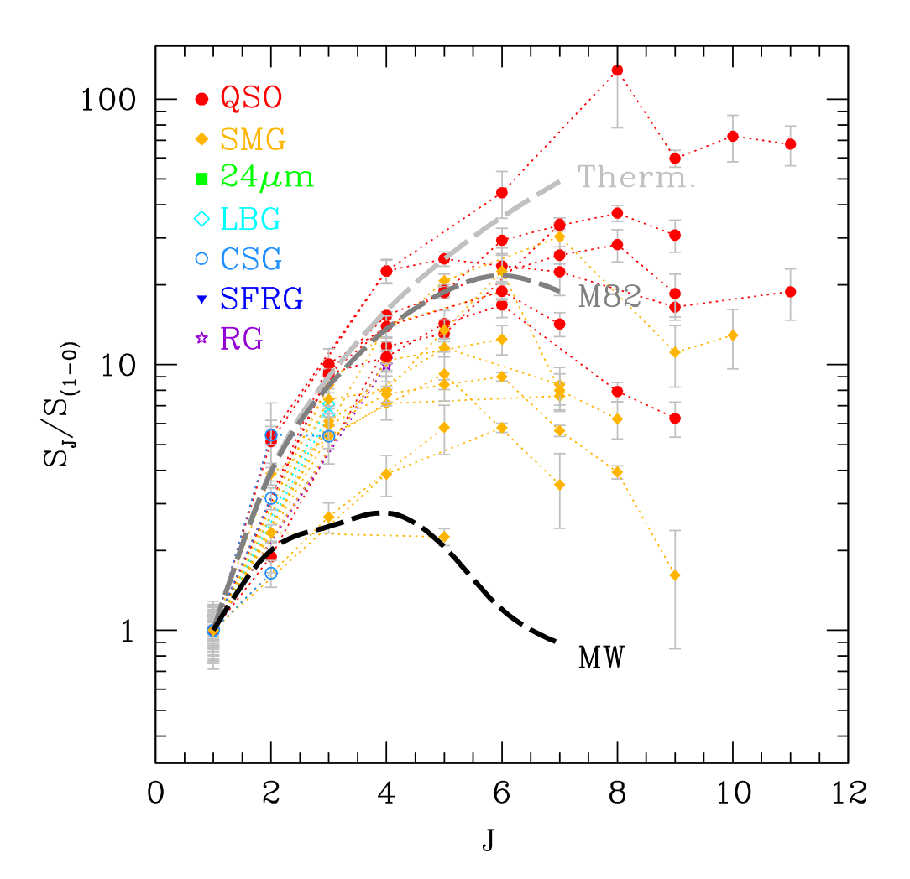
CO as a ISM mass tracer ?
from Carilli & Walter ‘12

Slide 28
at high z, need : robust and fast measure of ISM
CO –
ok , but ...
CO/H2 conversion factor
excitation dependence (often measure high J CO)
slow even w/ ALMA (hours per gal.)
alternative,
measure dust IR continuum + dust / gas ratio
(see Eales ‘12 , Scoville ’12, Santini etal 13)
ALMA cycle 0 & 2 projects (Scoville etal 13,15)

Slide 29
emitted SED -- increasing M_{dust}
L=10¹²L
M_{dust}=
10⁸ ➔
6x10⁹M
Scoville, 2011 Canary Is.
winter school lectures
peak shifts to longer λ for increased τ (or dust mass)
flux on long λ tail scales linearly with M_{dust}

Slide 30
R-J tail is optically thin,
➔
F_{RJ} = κ_{ν} T_{dust} ν² M_{dust} / (4πd²)
T_{dust} = 20-25 K in Gal. SF global T_{dust} doesn’t vary much calibrate : L_{ν} / M_{ISM} = < κ_{ν} T_{d} M_{ISM} / M_{dust} > local galaxies
Milky Way (Planck)
SMGs

Slide 31
local galaxies w/ total 850μm fluxes & ISM masses
1x10²⁰ erg/s/Hz/M
w/ less than factor
2 dispersion
Planck: Milky Way
➔
0.8x10²⁰ erg/s/Hz/M
β = 1.8 +- 0.1
850μm from Dale ‘05, Clements ’09, Dunne & Eales ‘09)

Slide 32
z = 2 – 4 SMGs with CO (1-0) obs. :
➔ same calibration as local gal. & MW

Slide 33
for ALMA Bands 3 - 7 predict :
3 σ in ~2 min
for M_{ISM} = 1x10¹⁰
20x faster
than CO !

Slide 34
ALMA Cycle 2 – observations --180 galaxies w/ 2 min !!! per gal. w/ Sheth, Aussel, Vanden Bout, Capak, Bongiorno, Casey, Murchikova, Koda, Pope, Toft, Ivison, Sanders, Manohar, Lee
60 @ z = 1 60 @ z = 2 60 @ z = 5
z = 1.15
z = 2.2
z = 4.8
band 5 (350 GHz) 5 (350 GHz) 6 (230 GHz)
stack obs for each z
in cells of M* and SFR

Slide 35
ISM masses vs sSFR = SFR / M*
M_{ISM} (10¹⁰ M)
peak M_{ISM} at z ~ 2 , decreases ~5x from z = 2 to 1
decrease from z = 2 to 5

Slide 36
ISM mass fraction :
M_{ISM} / (M_{ISM} + M_{stellar})

Slide 37
a single ‘linear’ SF law

Slide 38
compared w/Herschel stacking
SFR = 50 M_{ISM}^{1.1}
Alvarez Marquez
etal ‘15

Slide 39
gas depletion times

Slide 40
very different than previous work from CO
Daddi etal 2010
Genzel etal 2010
both used different CO conversion factors for SB and MS

Slide 41
our work ➔ single, ‘linear’ SF law !! at z = 1 to 6 and on MS and above MS huge accretion rates replace entire ISM w/i 2-4 x10⁸ yrs why is SF more rapid at z > 1 ?? dynamically driven SF ⬅ high σ_{v} gas & merging
Note – do not fit for T_{d} -- Lum.- vs mass-weigthed

Slide 42
RJ dust ➔ ISM mass estimate
calibrated against CO 1-0
positive : extremely fast
weak dependence on T_{d}
cautions : metallicity dependence will enter below 0.2 Z
T will be higher at L_{IR}/ M_{gas} > 30 L / M
T_{d} α ( L_{IR}/ M_{gas})^{1/5}

Slide 43
SF regulated by inflow, outflow, or HI ➔ H₂ conversion ?
HI conversion -- >10²¹ cm⁻² threshold not understood
strong evidence of SFR α M_{mol} (at low and high z)
scales of "stellar feedback” ?
OB* an SN disruption of GMCs ??
turbulence ??
molecular outflows in ULIRGs
SF differences at low and high redshift?
yes (shorter depletion times) ⬅ driven by dynamics
accretion and ISM properties vary with space and time ?
acc. absolutely critical

Slide 45


bathtub/reservoir model for ISM and SF to account for SF MS (M* , z) and Fisher-Tully
Bouche etal 2010, Dave etal 2011, Lilly etal 2013
Dekel & Mandelker 2014 , Peng etal 2015 mass conservation ➔ key ingredients :
1) K-S SFR law :
2) gas accretion:
3) limits : no accretion at : M_{h} < 10¹⁰⁻¹¹M , M_{h} > 10¹²M

Slide 46
predicts : evolution of MS SFR (z) slope of sSFR (M*) low mass galaxies have less time to grow ➔ downsizing of SF (high M* galaxies first) stellar mass fraction : M* / M_{h} = f* (M_{h})

Slide 47
problems ? supra-linear K-S law probably not correct :
M_{gas} ➔ M_{H2} at Σ_{HI} > 10²¹cm⁻² (see earlier) at high z , higher gas surface densities ➔ f_{H2} ~ 1 halo mass limits for accretion likely vary with environment and z mergers not included ε_{SF} (= SFR / M_{gas}) too low at high z ?? passive, red galaxies ??? why are the 2 disjoint populations

Slide 48
2 min detection rates -- 3 redshift ranges :
flux mass

Slide 49
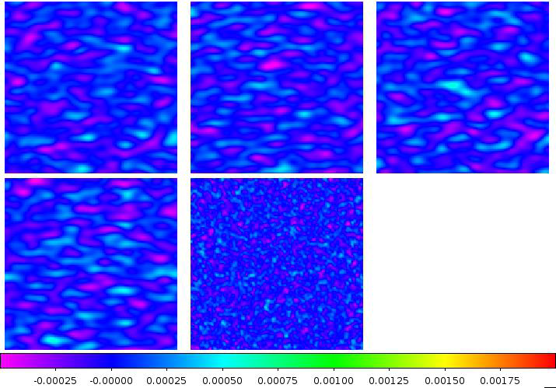
z = 2.2 images :

Slide 50
ISM masses vs sSFR = SFR / M*
M_{ISM} (10¹⁰ M)

Slide 51
ISM mass fraction :
M_{ISM} / (M_{ISM} + M_{stellar})

Slide 52
analytic fits :
ISM masses increase above the main sequence !!
➔ increase in SFRs above the MS
due to larger ISM masses

Slide 53
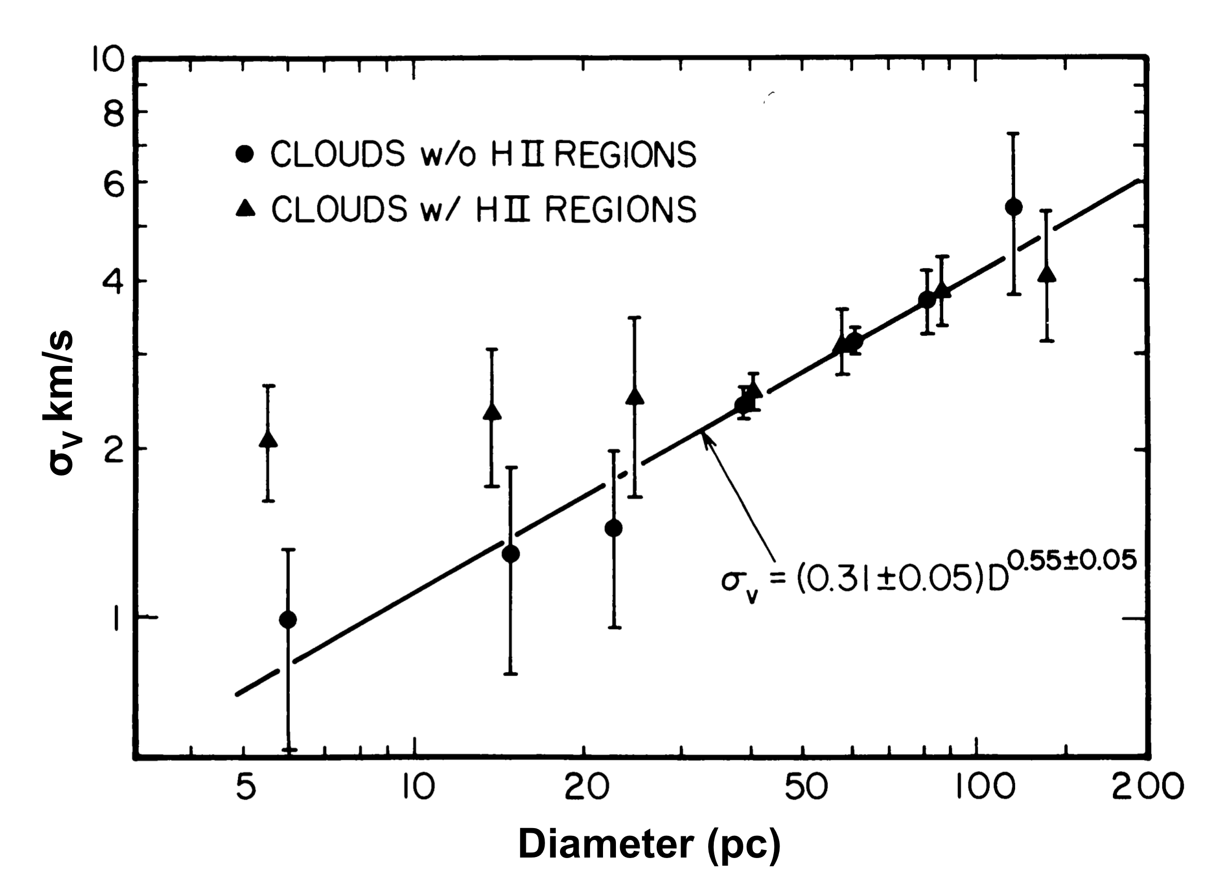
GMCs are self-gravitating (not in thermal press. equil.)
M = α R² Δv² /G w/ α ~ 1 linewidth and size ➔ virial mass M_{vir}
GMC
size-linewidth
relation
at 10K , thermal
width ~ 0.1 km/s !!
➔ supersonic turb.
galactic distributions

Slide 54
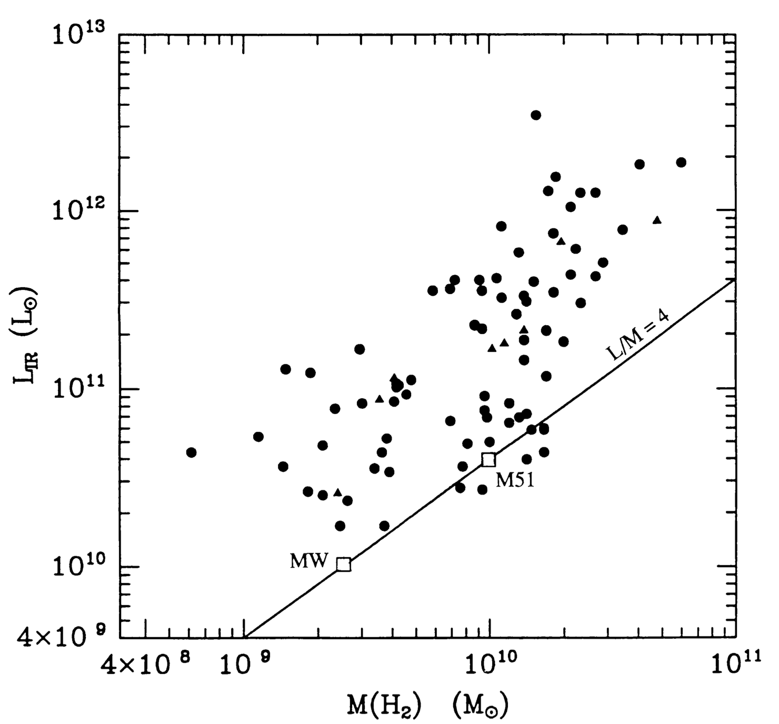
whole Galaxies : 2 SF modes :
normal / quiescent – SFR α M_{H2}
starbursts -- SFR / M_{H2} 5 – 50 times higher
starbursts
(dyn. driven)
normal SF

Slide 55
GMCs / H₂ can’t be confined to arms
continuity (mass cons.) =>
M_{H2} / τ_{H2} = (M_{HI} + M_{HII}) / τ_{HI-HII}
HI & HII
H₂
gas fraction ~80% molecular
➔ M_{H2} ~ 4 x M_{HI}+M_{HII}
τ_{H2} = τ_{HI-HII} M_{H2} / (M_{HI} + M_{HII}) ~ 4 x τ_{HI-HI}
=> τ _{H2} >> τ_{HI-HII} ≥ 3 x 10⁷ yrs
H₂
HI & HII
typical H₂ lifetime >> 10⁸ yrs !!
( lifetime of H₂, not necessarily GMC )
cloud assoc. w/i arms shear apart upon leaving arms

Slide 56
equipartition of cloud KE
➔ massive clouds w/ lowest σ_{v}
requires cloud last
several GMC-GMC
collision times
τ_{GMC-GMC} >~ 10⁸ yrs

Slide 57
estimating H2 masses – for resolved clouds M_{vir} correlated with L_{CO} (= area T_{CO} Δv)
How can an optically thick CO line measure mass ?? later

Slide 58
metallicity variations ?
draine ‘07

Slide 59
ISM contents at high z – MS & above MS
ALMA ➔ dust continuum
120 & 180 galaxies (Scoville etal ’14 & 15)
ISM critical for SF & AGN also constraints on baryon accretion / feedback
➔ new view of SF

