Slide 1
Open Questions in Galaxy Morphology
Q1. Do galaxies get born in a preferential morphology? At which cosmic epoch do the disks/spheroids dichotomy take place?
Q2. Which physical parameter controls galaxy morphology: Angular momentum? Stellar mass? Dark matter halo mass?
Q3. What is the role of merging on galaxy transformation with cosmic time?
Q4. What is the role of secular evolution?
Q5. Do the galaxy structure plays a role on the quenching process?

Slide 2
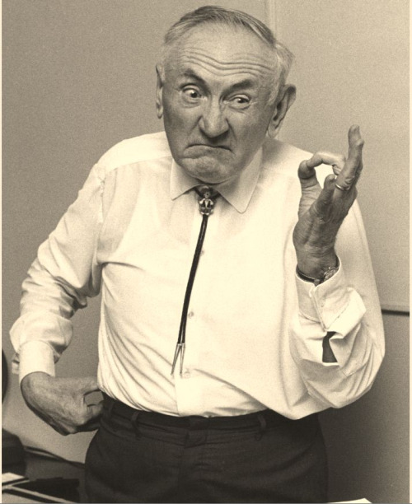
Would be Zwicky happy with our Discussion?

