Slide 1
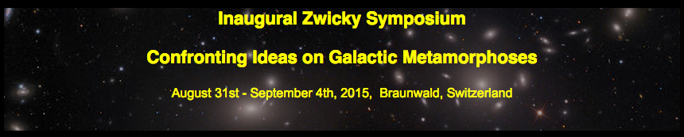
Galactic Metamorphoses: Role of Structure
Christopher J. Conselice

Slide 2
Galactic Metamorphoses – What do we mean?
We know galaxies evolution occurs from observations.
Further questions to address are:
When/if and how do galaxies transform morphological
(i.e., disks/ellipticals/peculiar transformations)
Size/structure evolution – galaxies compact at high-z
Stellar mass evolution – what drives the assembly of galaxies?
Does it relate to, or is it driven by the structural/morphological
changes in galaxies?

Slide 3
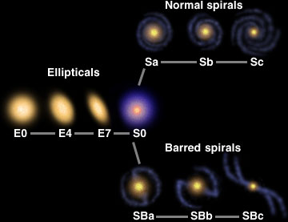




Galaxy structure: Galaxy morphology
Local Universe
98% of all nearby bright galaxies
can be placed into a Hubble type
Hubble types are the z = 0 final state of
bright galaxy evolution
Ellipticals have old stellar populations, spirals have both old and young
components while irregulars are dominated by young stars
No/little cold gas or star formation
Cooling gas with star formation
Old stars
Young stars

Slide 4
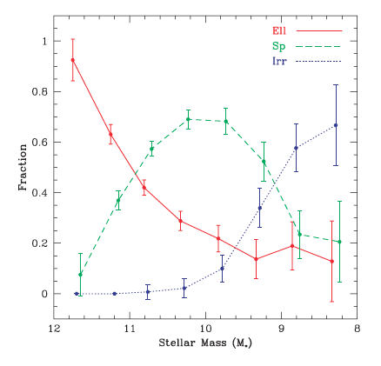
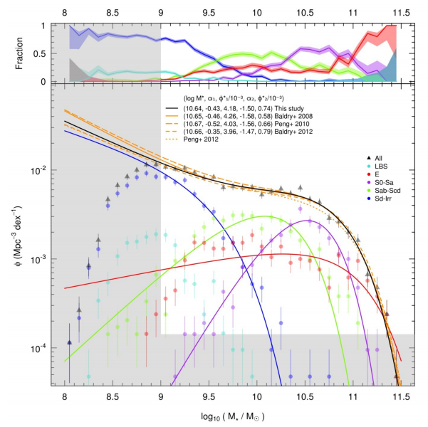
End product of galaxy formation highly regulated and
dependent on stellar mass for reasons that are not understood
Conselice 06
Kelvin+ 2014 (GAMA)

Slide 5
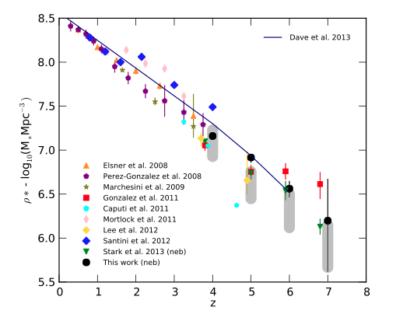
The formation of stellar mass – direct measures
50%
10%
1%
Observed integrated stellar mass density vs. redshift

Slide 6
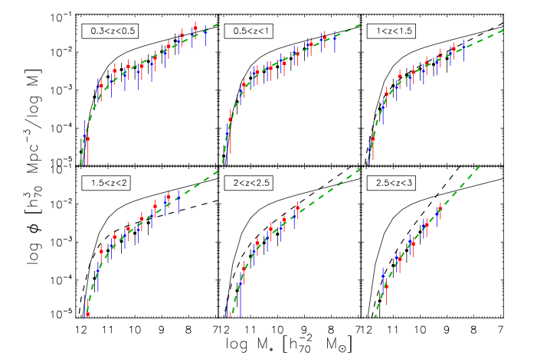
Mass function shows that massive galaxies form quickly
Mortlock+14 (also e.g., Stanfo+15; Muzzin+13; Marchesini+10)
Most massive galaxies are in place by z = 1

Slide 7
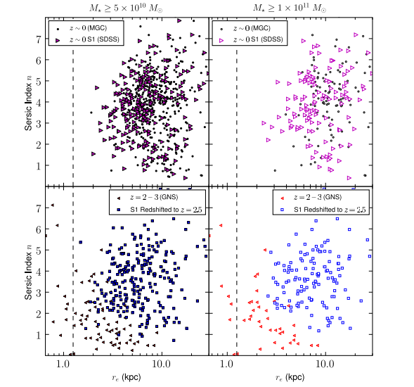
However galaxies at z = 2.5 are different from nearby massive galaxies
Nearby massive
galaxies
Weinzirl+11

Slide 8
Galaxies at z = 2.5 --- different from nearby massive galaxies
Same mass
but at z > 1

Slide 9
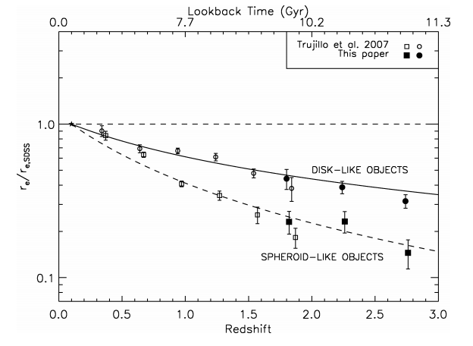
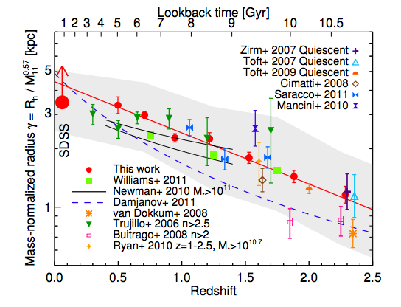
Size evolution – now well established
Buitrago+08
Newman+12
Scales as ~(1+z)^{-0.82 to -1.5}

Slide 10
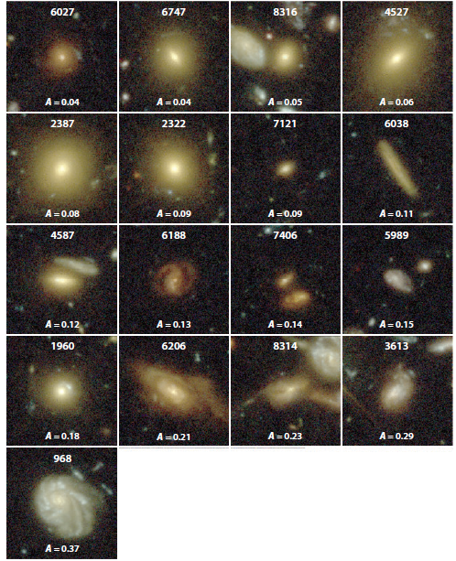
Disk/elliptical/peculiar
evolution – visual
morphologies
z < 1 massive
Galaxies in UDF

Slide 11
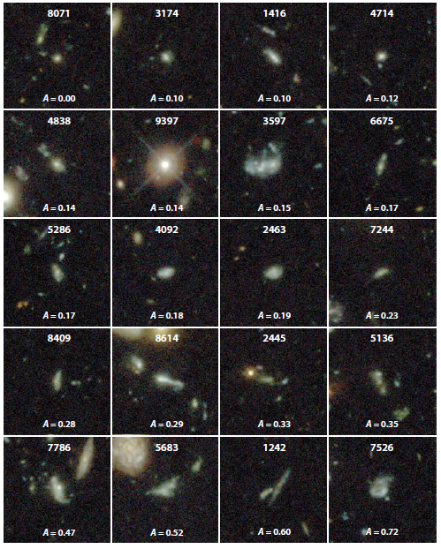
z > 1 massive
Galaxies in UDF

Slide 12
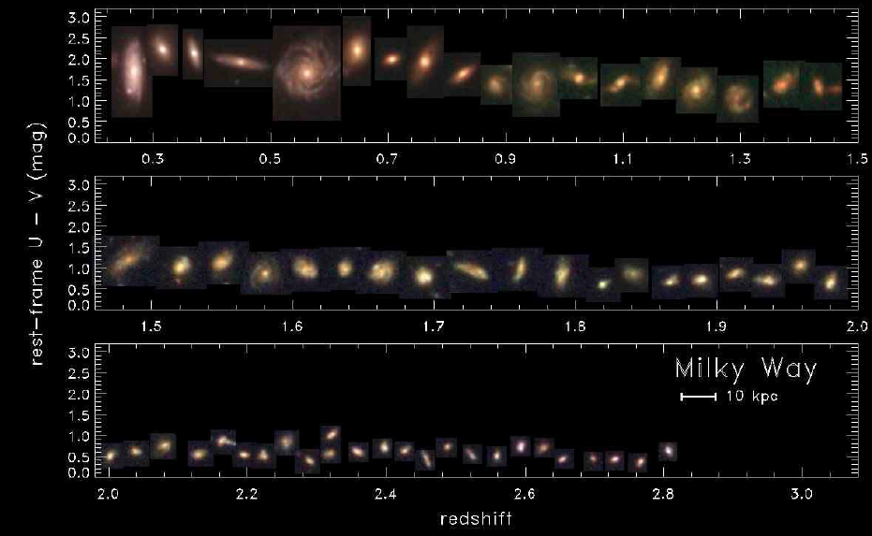
Milky Way mass progenitors
Papovich +15 (CANDELS)

Slide 13
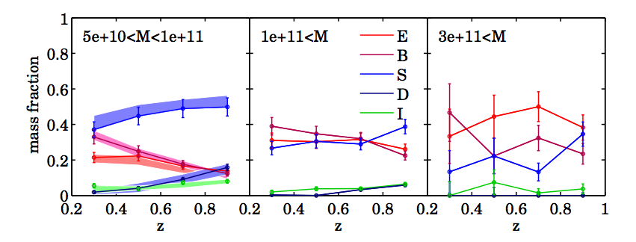
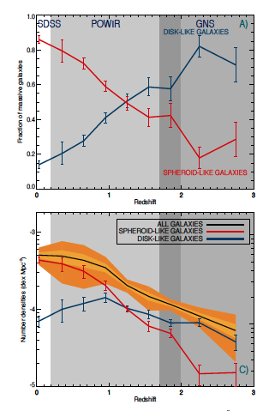
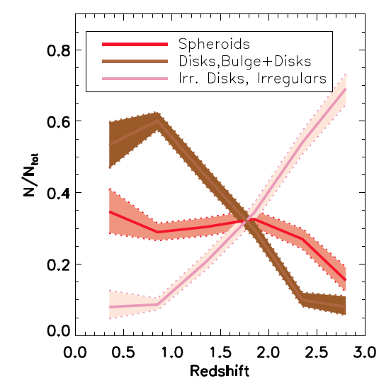
Massive galaxies become more disky/peucliar at higher redshifts
Oesch+10
Buitrago+13
Huertas-Company+15

Slide 14
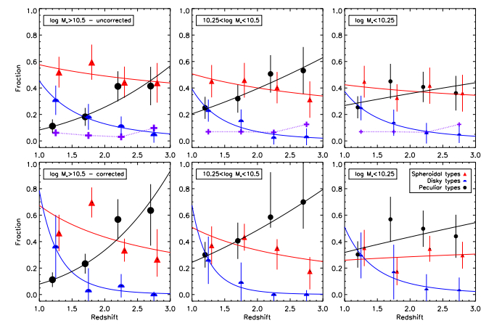
There is a dependence on stellar mass on morphological evolution
More massive systems become ‘Hubble-types’ before lower masses
Ztrans ~ 1.85

Slide 15
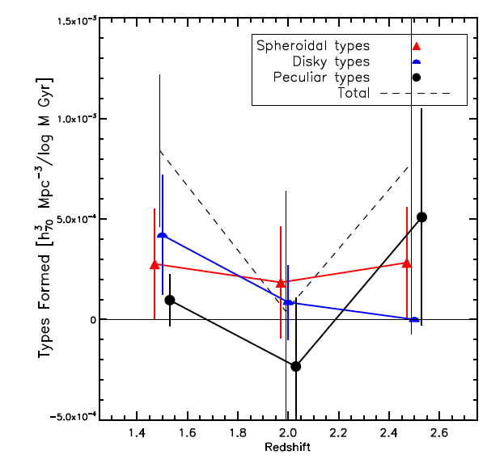
Rate of change in the formation of Hubble types
Roughly constant formation rate for E/Spirals at 1 < z < 3

Slide 16
How can we form the disk/elliptical bifurcation?
Possible Processes
Mergers - two or more galaxies colliding to form a more massive system - can halt SF, changes morphology
Harassment - high speed galaxy interactions removing mass (Moore et al. 1999) - unlikely to be important at low relative velocities (i.e., field galaxies), changes morphology
Strangulation - removal of hot gas - halts star formation
Ram pressure stripping - removing gas from disks due to traveling in an intragroup medium, depends upon group σ²
Non-gravitational processes (AGN, SNe) - hard to constrain observationally, but likely present

Slide 17
Galaxy Mergers
Should be common - dynamical friction time-scale
goes as (group σ) ³
● ~250 km/s upper limit for dragging galaxies into center
of a group over a Hubble time (groups at high-z common)
Low redshift merger rate expected to be low, around 2% of galaxies in groups merge per Gyr (observed)
● At higher redshift the mass density increases as
H² ~ (1+z)³. Results in a higher merger rate of √(ρ)~(1+z)^{1.5}

Slide 18
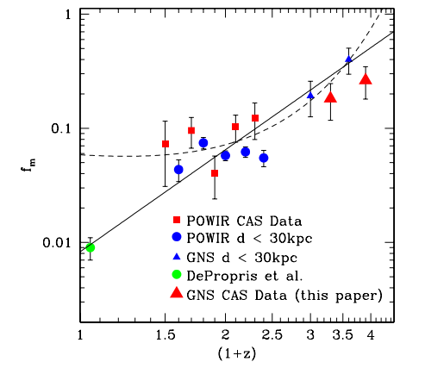
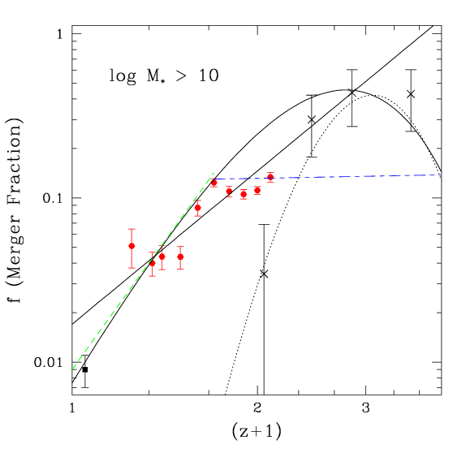
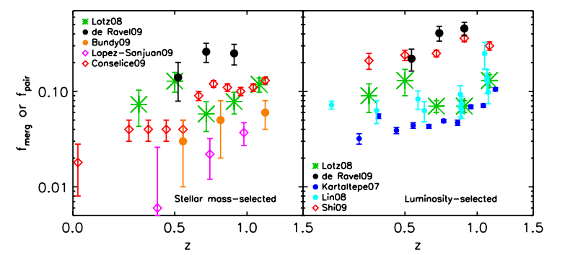
Major mergers – measure with structure
Conselice+09
Bluck+12
Lotz+11
Mergers evolve as (1+z)¹⁻³ to z = 3

Slide 19
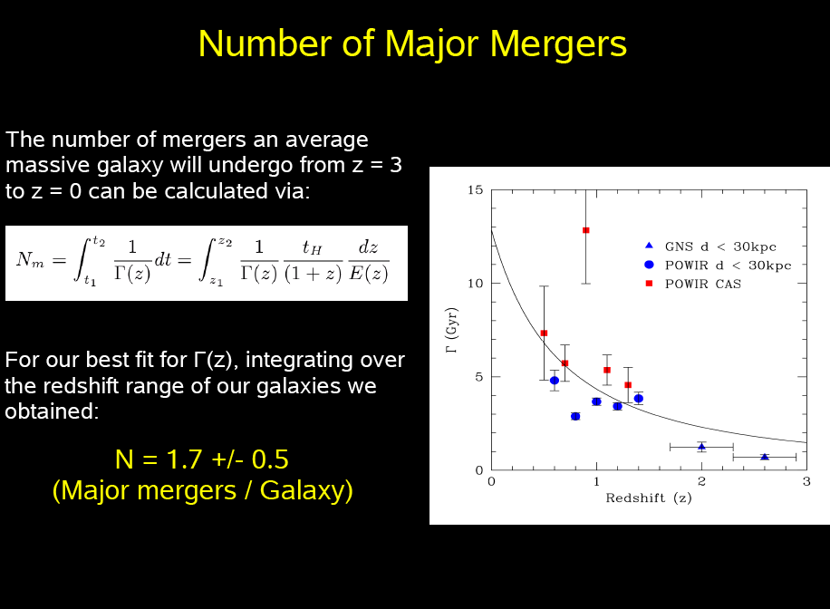
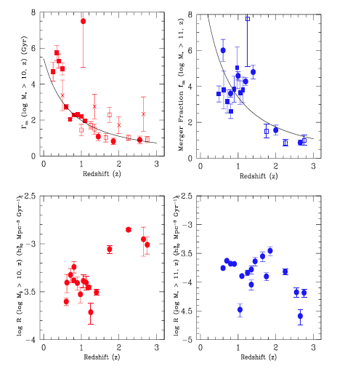
(for stellar mass selected samples, Conselice 2014, ARAA)
Roughly doubles the stellar masses of galaxies from z=0 to 3

Slide 20
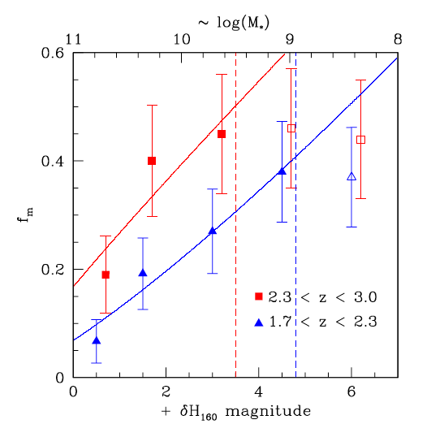
Are there minor mergers?
More minor mergers add about
the same mass as major
mergers
Total mass added from
all mergers from 1<z<3
is around 50% for a
mass selected sample
Bluck+12

Slide 21
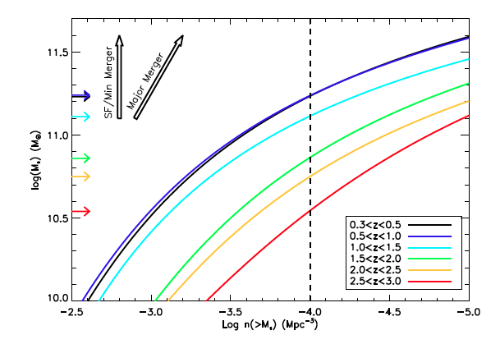
Want to trace the same galaxies over time
At constant mass selection only 3% of galaxies in a z=0.4 sample
would be in a z = 3 selection - a significant progenitor bias

Slide 22
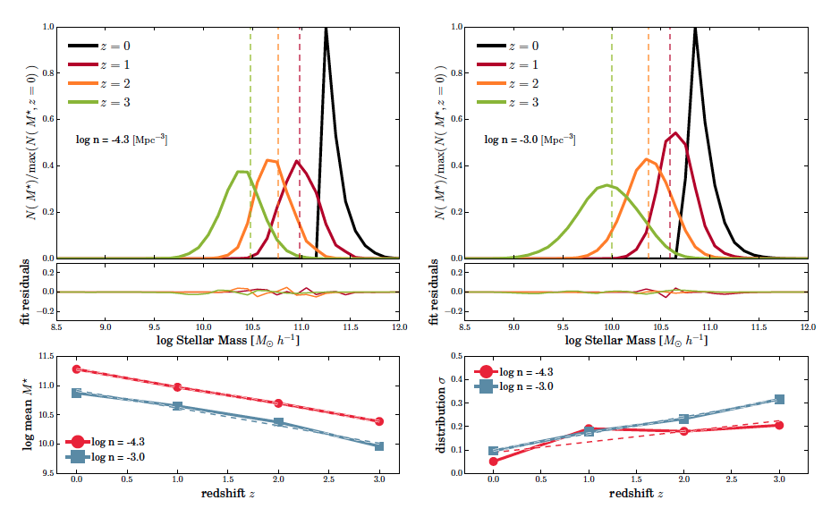
Evolution of z=0 massive galaxy selection
There is no 1:1 mapping, but a large scatter
Mundy et al. 2015

Slide 23
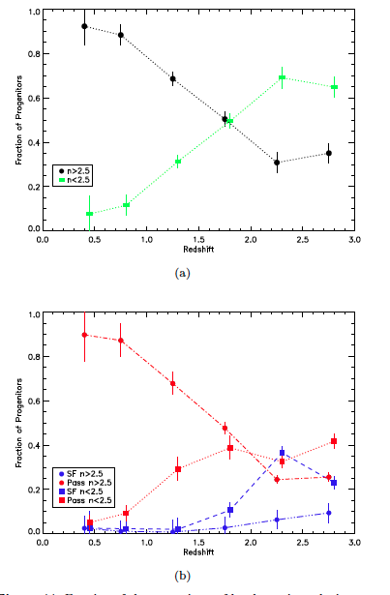
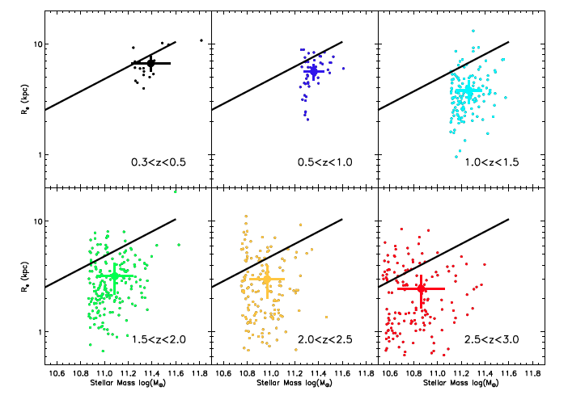
Using a constant number density selection
Morphological evolution
Shows strong change in the
Sersic indices for any selection
and a progression of moving
from low n galaxies to high n
red systems
Not as strong size evolution

Slide 24
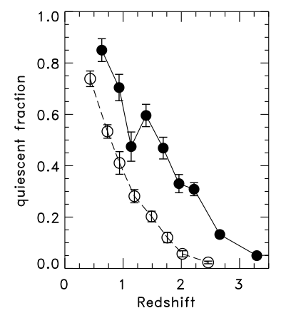
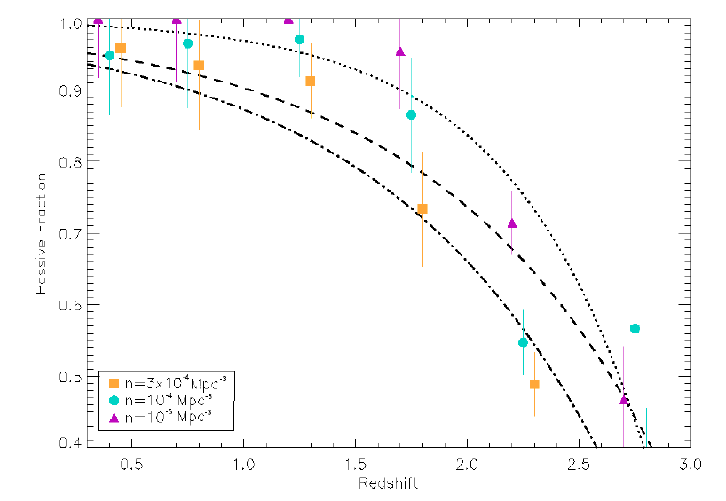
Passive fraction increases at lower-z
Ownsworth+15
Papovich+15

Slide 25
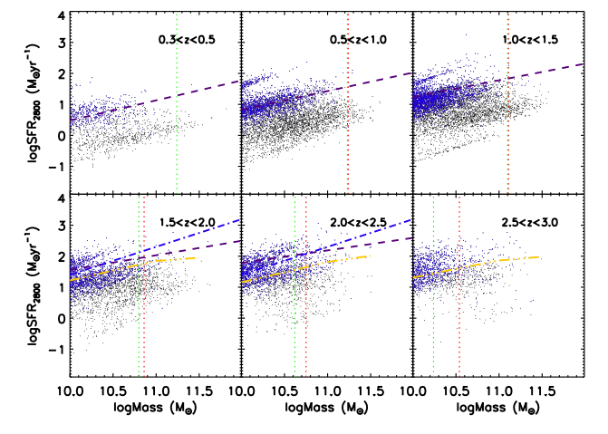
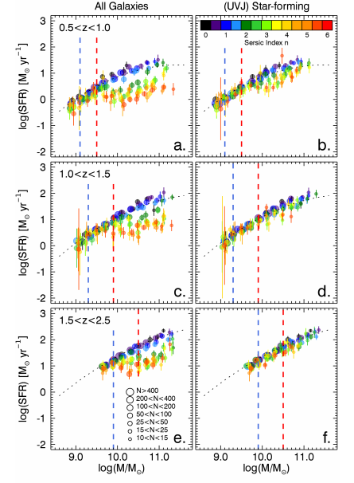
The star formation rates as a function of stellar mass
Ownsworth+14
Whitaker+15

Slide 26
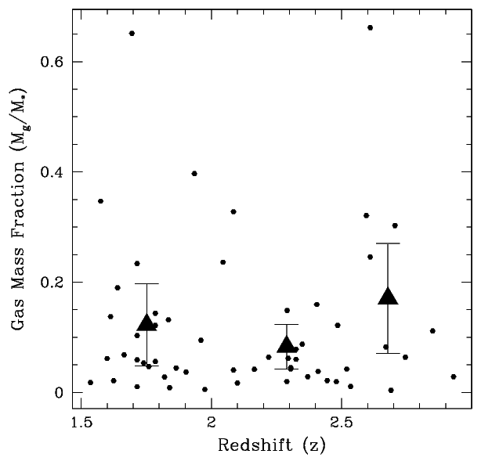
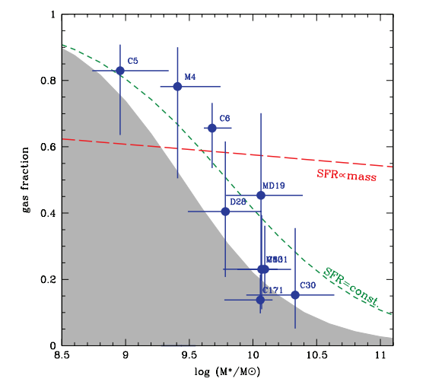
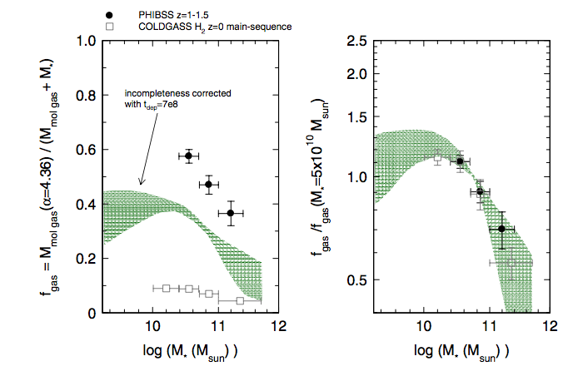
Gas mass fractions
Conselice+13
Mannucci+09
Tacconi+13

Slide 27

Do we have a consensus about how massive galaxies
form at 1.5 < z < 3?
Stellar mass evolution
Gas mass evolution
Observed condition
Amount of
gas accreted
Integrate: Mass added from SF ~ Mass added from major merging
However - gas mass fraction for log M > 11 is less than 0.2

Slide 28




The amount of gas added from accretion (or very minor mergers)
Over 1.5 < z < 3 (2.16 Gyr)
Average amount of gas accreted
Results in accretion rate of

Slide 29
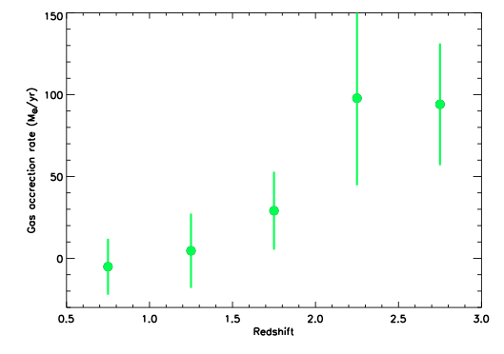
Gas accretion rate history for massive systems over cosmic time
Ownsworth+14

Slide 30
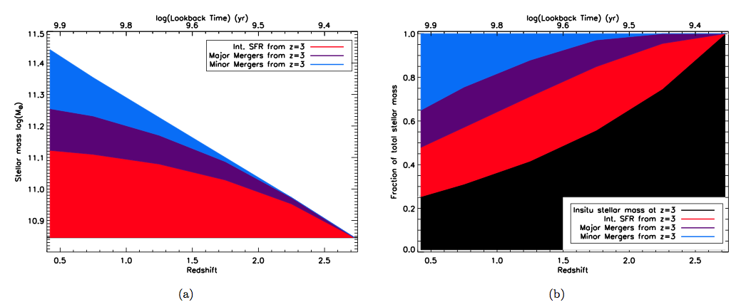
Can determine the relative contributions to
massive galaxy formation from z = 3
Mergers only ~50% of formation of stellar mass since z ~3

Slide 31
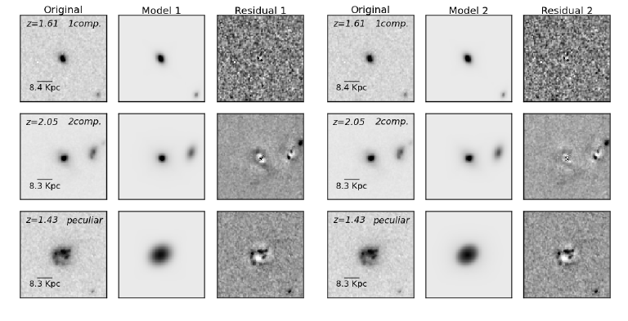
Bulges and disks at high-z

Slide 32
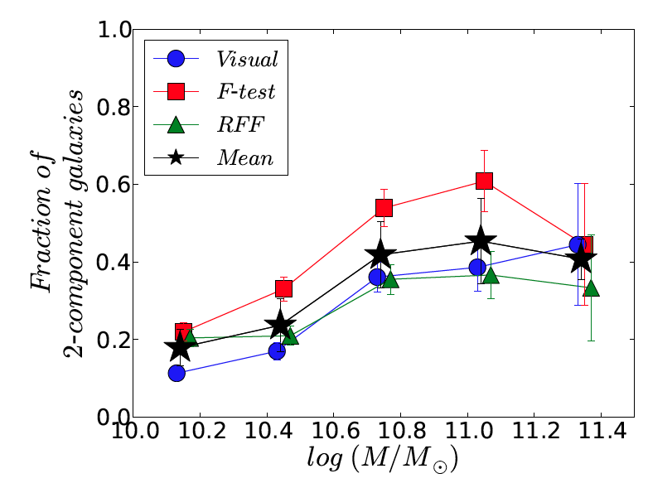
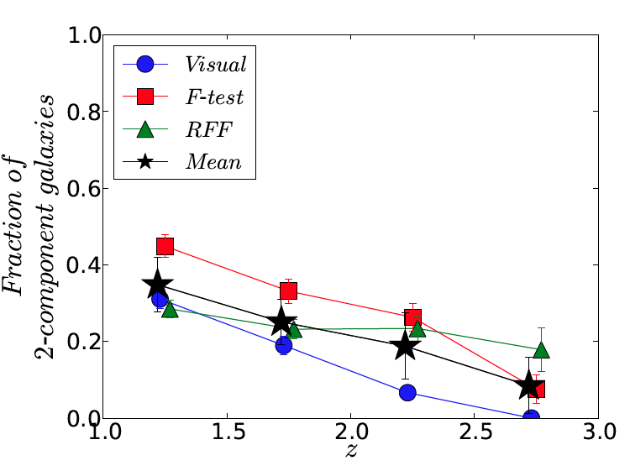
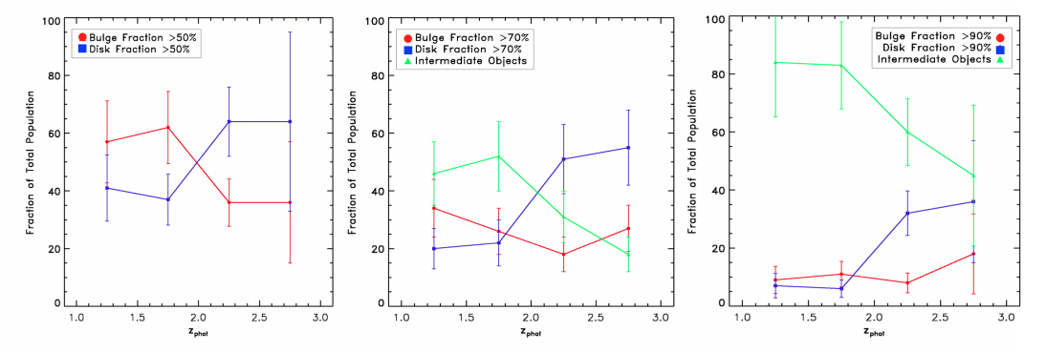
Two component galaxy evolution at 1 < z < 3
Margalef-Bentabol+15
Bruce+12

Slide 33
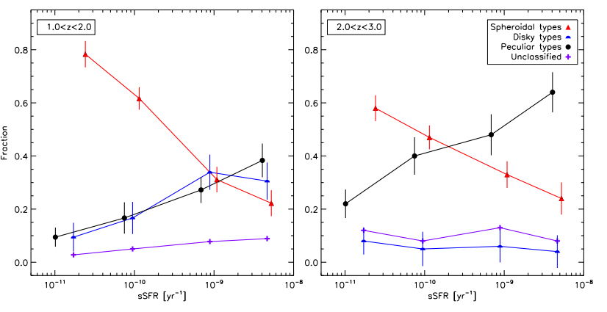
How does structure drive galaxy assembly?
Peculiars dominate the fraction of high sSFR systems at z > 2

Slide 34
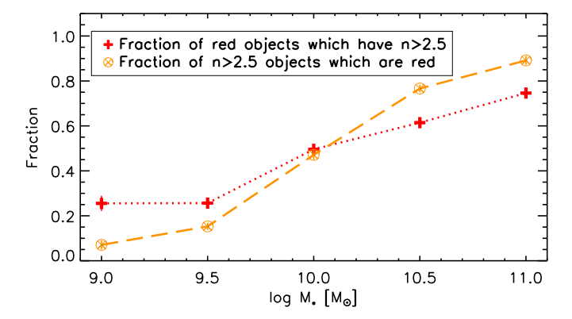
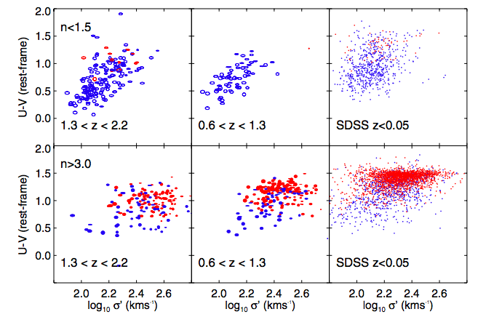
Quenching and structure
at z~2
Mortlock+15
Bell+12

Slide 35
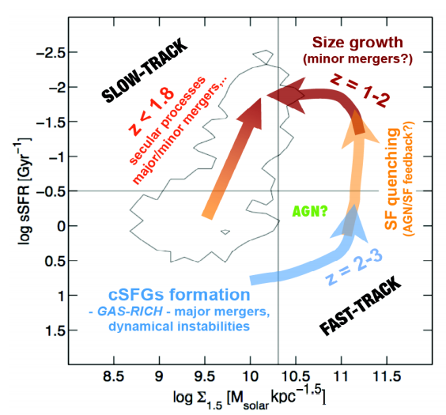
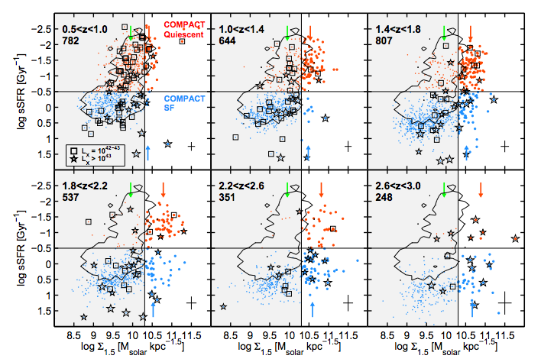
Relation to surface mass density
Barro+13

Slide 36
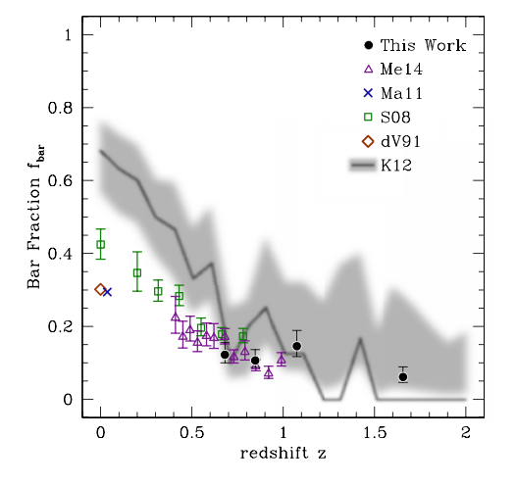
Bars in galaxies at z < 2
Simmons+15

Slide 37
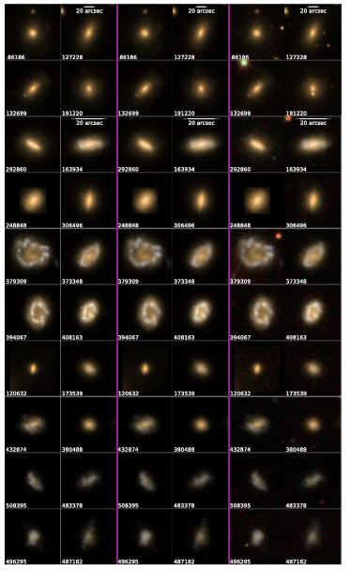
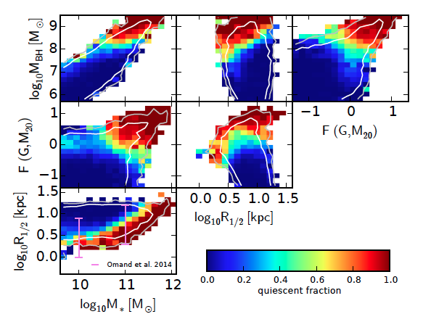
Can almost match distribution
Seen in real galaxies
Illustris simulation (Snyder+15)

Slide 38
