Slide 1
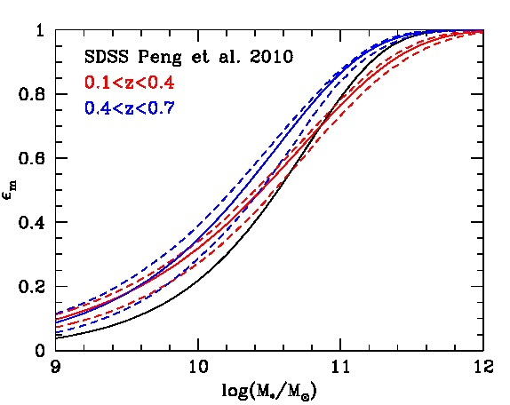
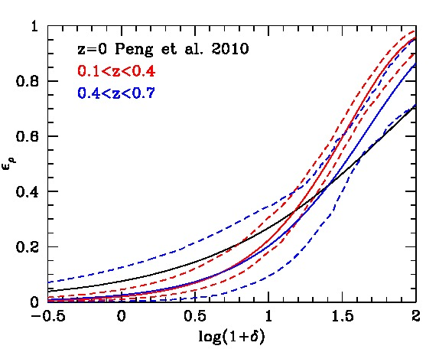
Mass and environmental quenching over time
Mass quenching
Environmental quenching
Constancy over time: physical processes responsible for quenching act in the same way over time
KK+ in prep
Dominant mechanism for quenching of galaxies changes with time
Kovač et al. 2014

Slide 2
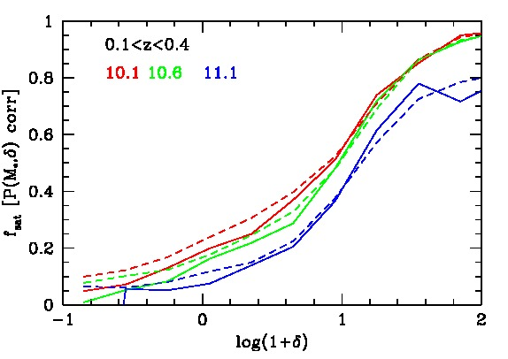
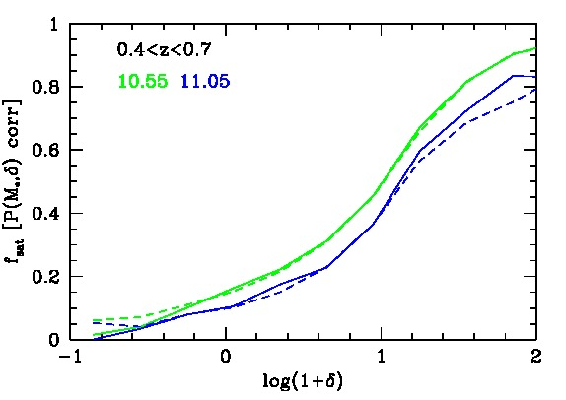
Fraction of satellites as a function of local environment and mass in 0.1<z<0.7
ε_{ρ} (δ) increases with δ; if satellites are responsible for the environmental quenching
then ε_{sat} (M*,δ) = ε_{ρ} (δ)/ fsat(M*,δ)
Environmental quenching
Kovač et al. 2014

