Slide 1
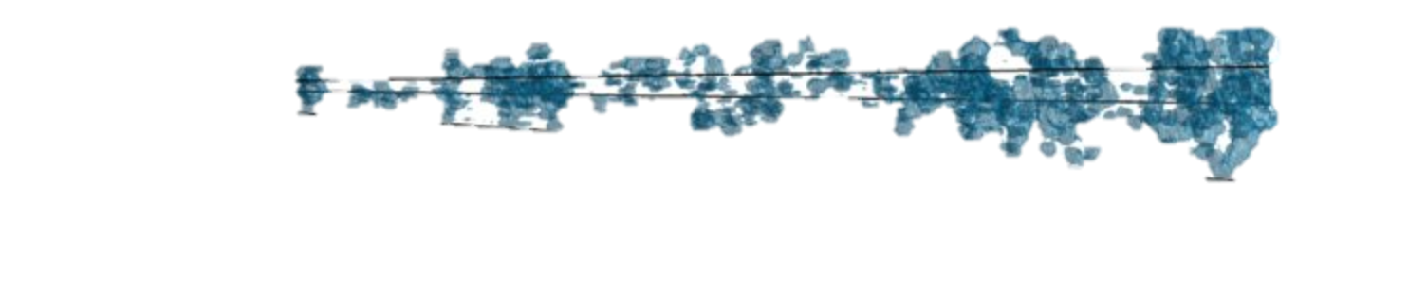
Katarina Kovač (ETH Zürich)
Environmental quenching disentangled: centrals, satellites,
and galactic conformity
Katarina Kovač, ETH Zürich
Collaborators: Simon Lilly, Christian Knobel, Yingjie Peng, Joanna Woo, Aseem Paranjape, Will Hartley, Isha Pahwa

Slide 2
Overview
Quenching of star formation in different environments over 0<z<0.7: focus on the role of centrals and satellites and galactic conformity
Data: 1) DR7 SDSS with ~200,000 galaxies with r<17 at z≈0
2) final zCOSMOS-bright (i < 22.5) data set; about 17,000
galaxies with reliable redshift in 0<z<1
Empirical approach – finding the relations in the data
Given the associated uncertainties, our statements should be understood as approximations to physical reality, rather than physically exact formulae

Slide 3
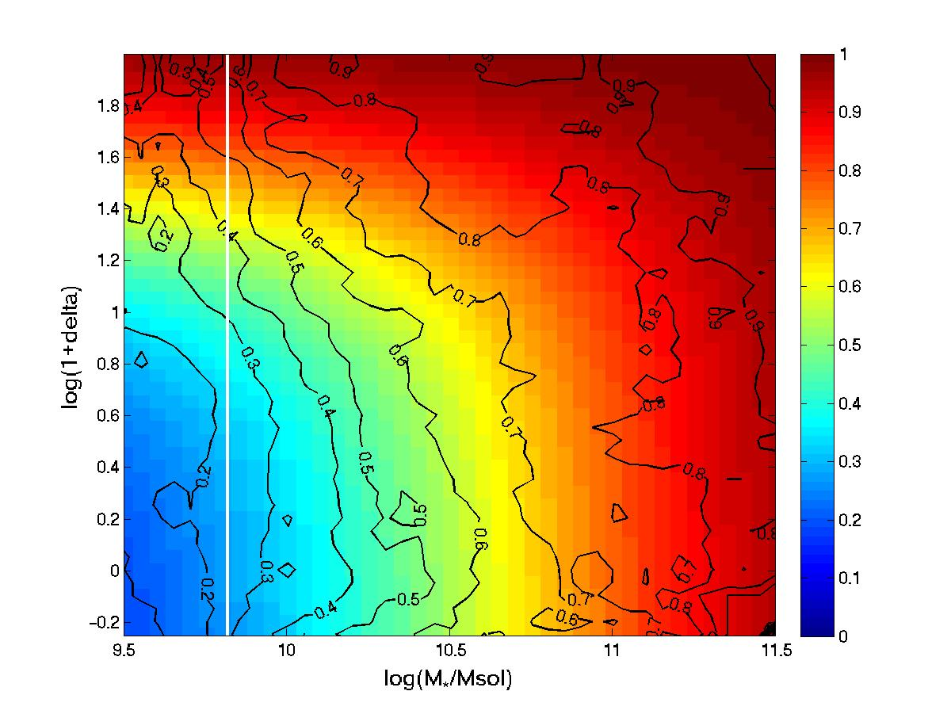
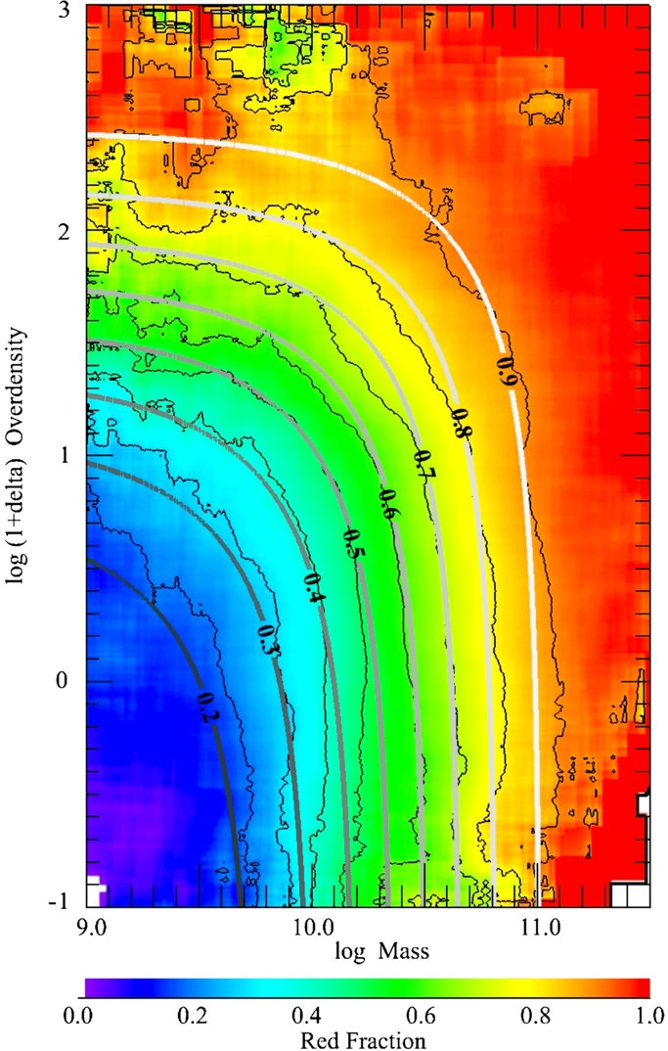
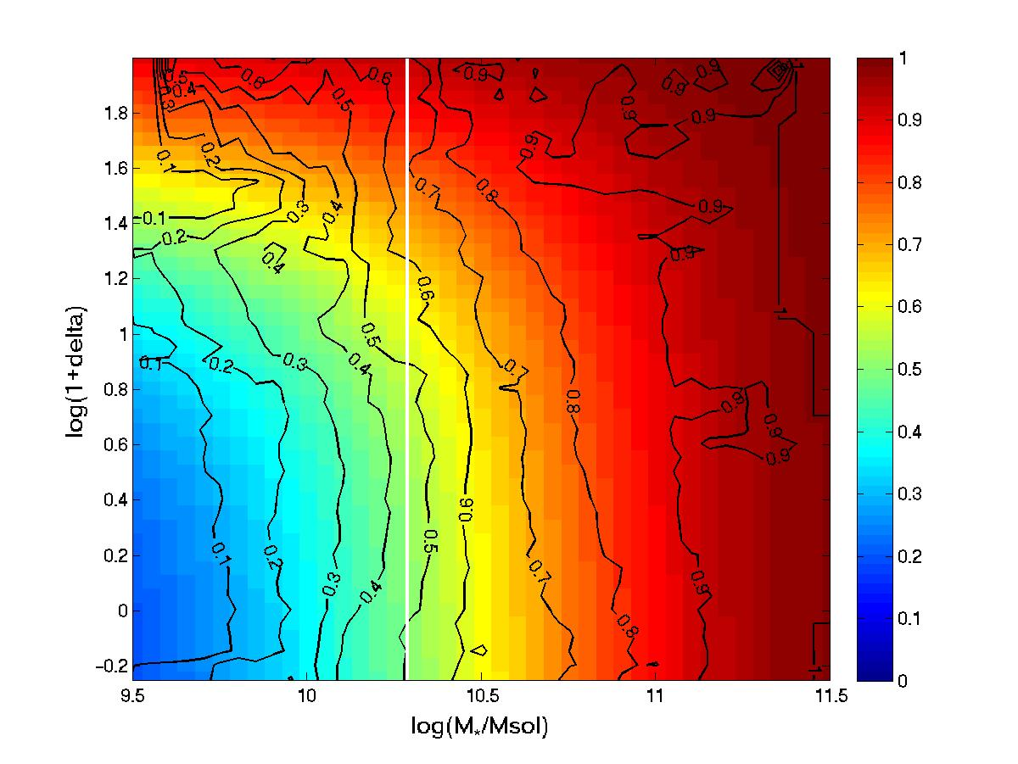
Differential effect of stellar mass and environment in 0<z<0.7
f_red(δ,M*) = 1 – exp[(-((δ/p1)^p2) – ((M*/p3)^p4)] = ε_{m}(M*)+ ε_{ρ} (δ) – ε_{m} (M*)ε_{ρ} (δ)
(Baldry et al. 2006, see also Peng et al. 2010)
Peng, Lilly, Kovač et al. 2010
KK+ in prep
Kovač et al. 2014
Separability holds to a good degree at least up to z<0.7; possible cross-term within the errors

Slide 4
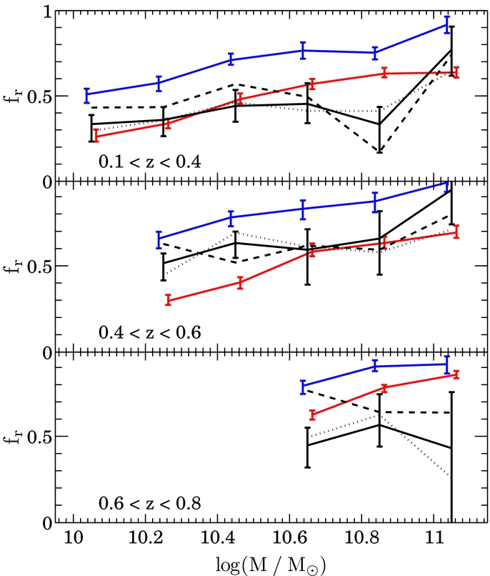
Central/satellite dichotomy: satellite quenching f(mass) at 0.1<z<0.8
High-fidelity 20k zCOSMOS catalogue (Knobel et al. 2012)
ε_{sat} (m) = [f_{r,sat}(m) – f_{r,cen}(m)]/[f_{b,cen}(m)]
Satellite quenching: constant at all masses, mirroring z~0 SDSS results; no evolution with redshift
Knobel, Lilly, Kovač, et al. 2013

Slide 5
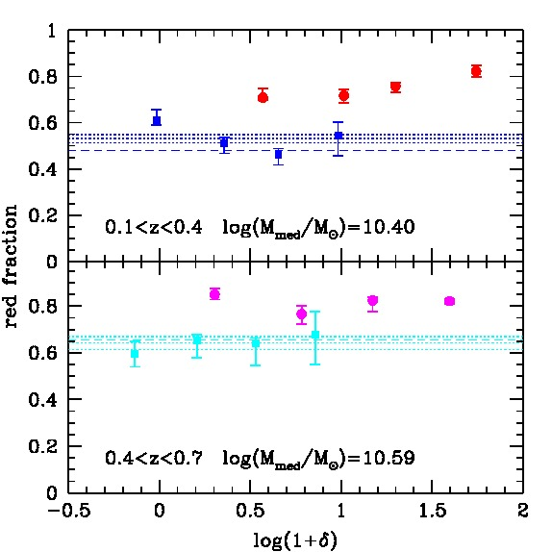
Fraction of red centrals and satellites as a function of local environment in 0.1<z<0.7
Analysis in the mass-matched samples to obtain reliable results
Centrals consistent with being independent of δ, i.e. fr,cen is consistent with ε_{m} (>95%) where
f_red = ε_{m} + ε_{ρ} - ε_{m} ε_{ρ}
Red fraction of satellites require some additional form of quenching in addition to ε_{m}
Kovač et al. 2014

Slide 6
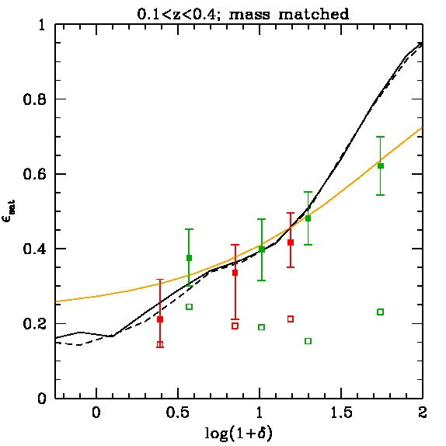
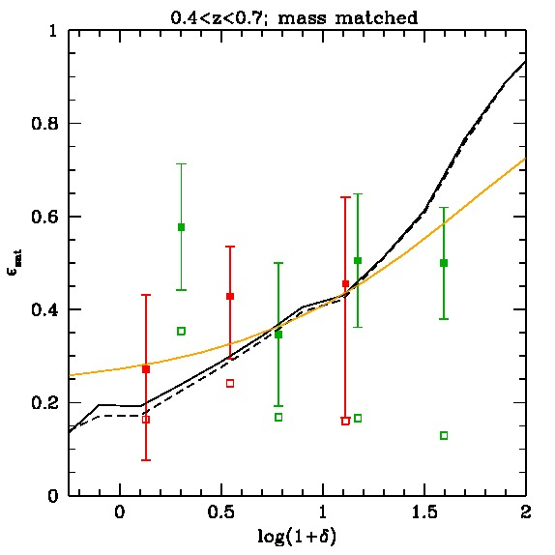
Central/satellite dichotomy: satellite quenching f(δ)
ε_{sat} (M*,δ) = [f_{r,sat}(M*,δ) – f_{r,cen}(M*,δ)]/[f_{b,cen}(M*,δ)]
Satellite quenching: consistent with ε_{ρ}/fsat(, when centrals are not dependent on environment; mirroring the z~0 SDSS (Peng et al. 2012) results
Satellites are the major drivers of the overall observed environmental differences up to z~0.7
Kovač et al. 2014

Slide 7
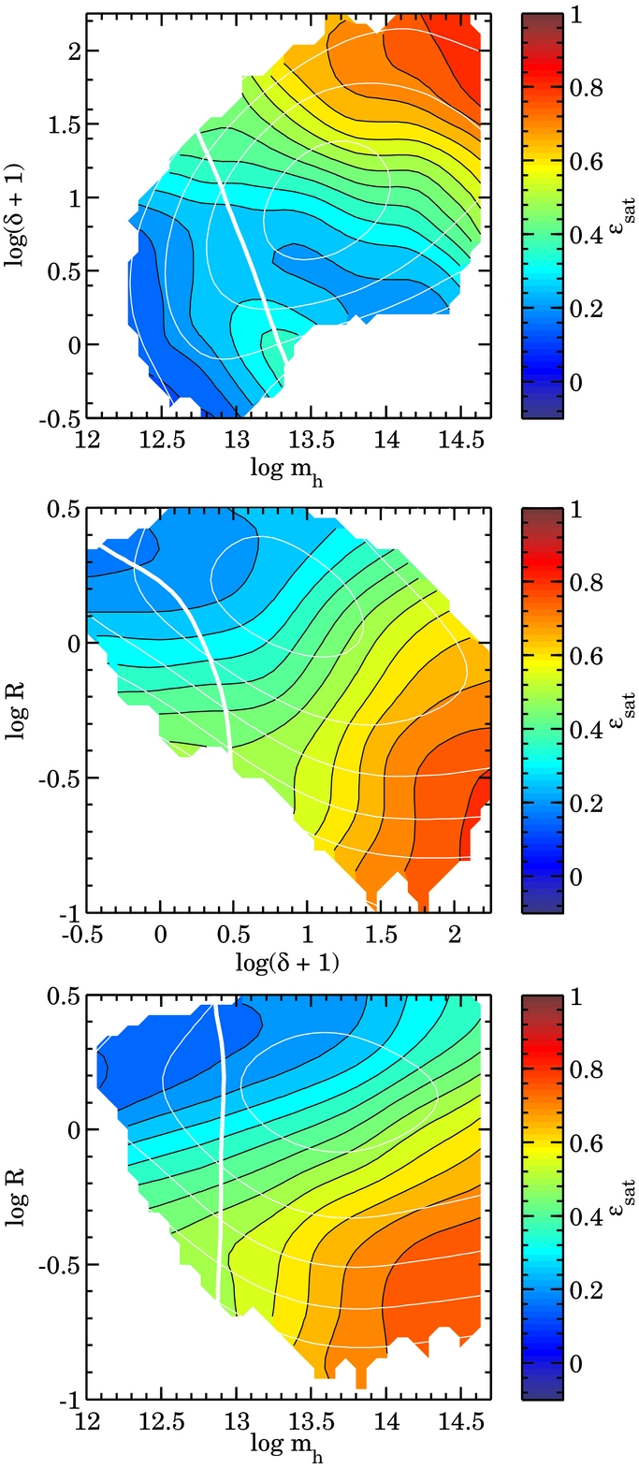
Satellite quenching efficiency (z=0) as function of environmental parameters
All of these environmental parameters are important in satellite quenching.
Knobel, Lilly, Woo, Kovač 2014

Slide 8
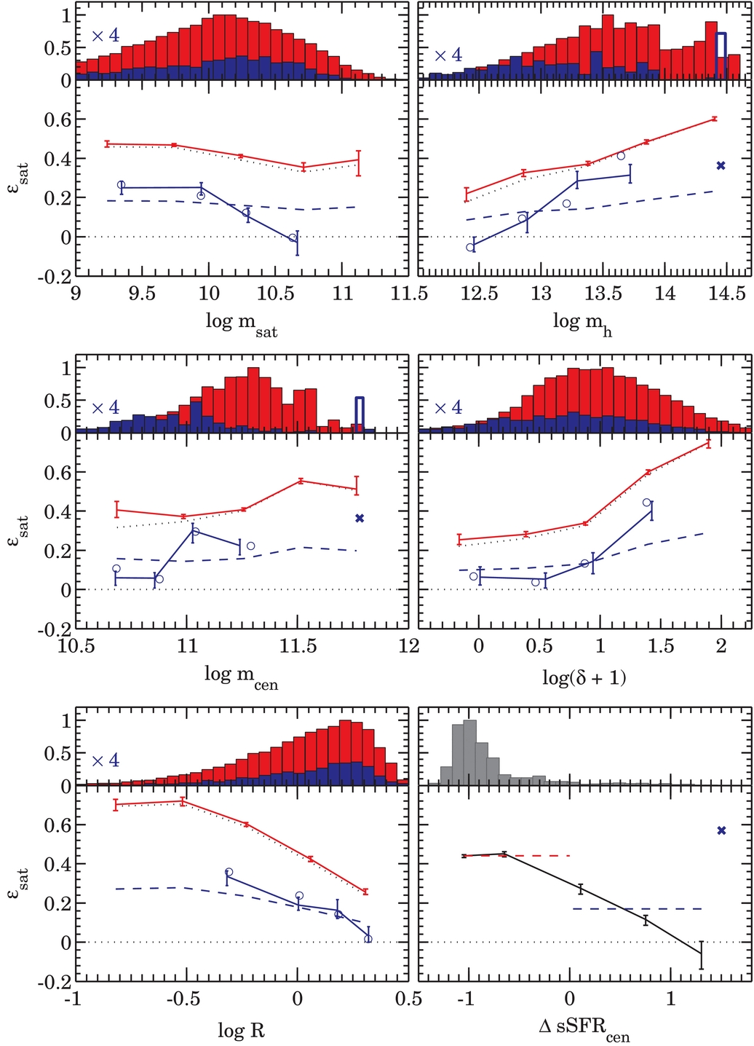
Satellites are the major drivers of the overall observed environmental effects … but … properties of satellites depend on properties of their central
Satellites of quenched centrals ~2.5 times more likely to be quenched than satellites of star-forming centrals
Signal vary in similar way with the environmental parameters for satellites of both quenched and star-forming centrals
Existence of some “hidden variable” shared by the centrals and satellites in the same group
Knobel, Lilly, Woo, Kovač 2014

Slide 9
Conformity at z>0
0.1<z<0.4
0.4<z<0.7
f_{q|sat}
f_{q|sat}
<ε_{sat}>
<ε_{sat}>
log(m*)
log(m*)
Satellites of quenched centrals are more likely to be quenched than satellites of star-forming centrals up to z~0.7
Kovač K.+, in prep.

Slide 10
Conformity at z>0
0.1<z<0.4
0.4<z<0.7
Existence of some “hidden variable” shared by the centrals and satellites in the same group:
1) physical but difficult to observe (hot gas, entropy etc),
2) physical but almost unobservable (i.e. assembly bias)
3) errors in the parameters
<ε_{sat}>
log(m_{cen})
<ε_{sat}>
log(1 + δ)
<ε_{sat}>
Caution: slopes are unconstrained
log(m_{h})
Kovač K.+, in prep.

Slide 11
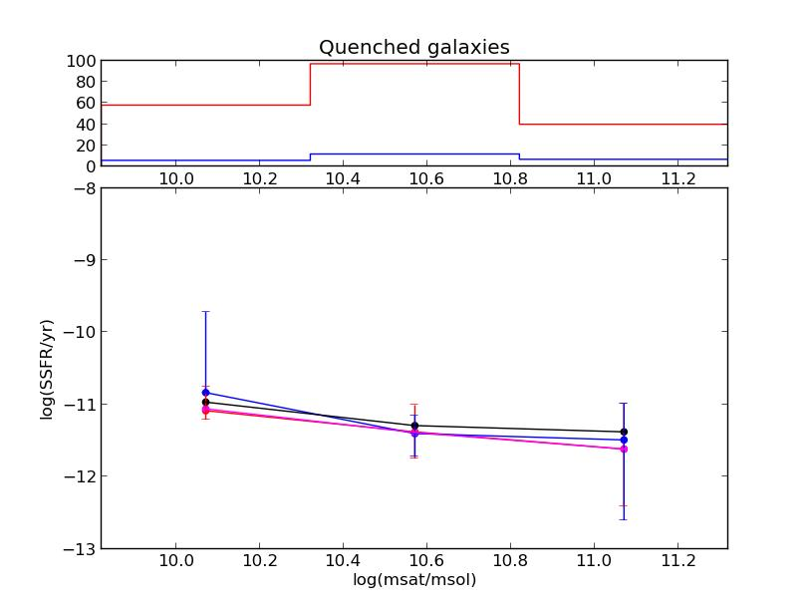
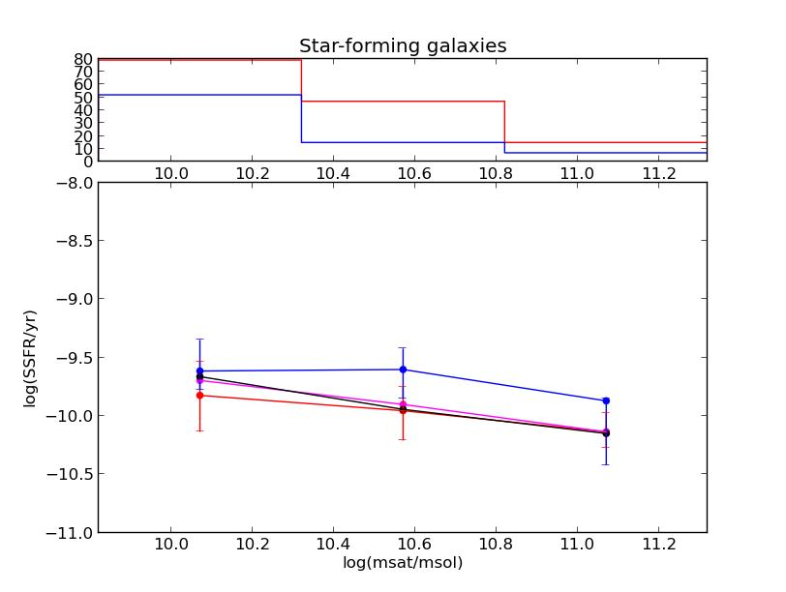
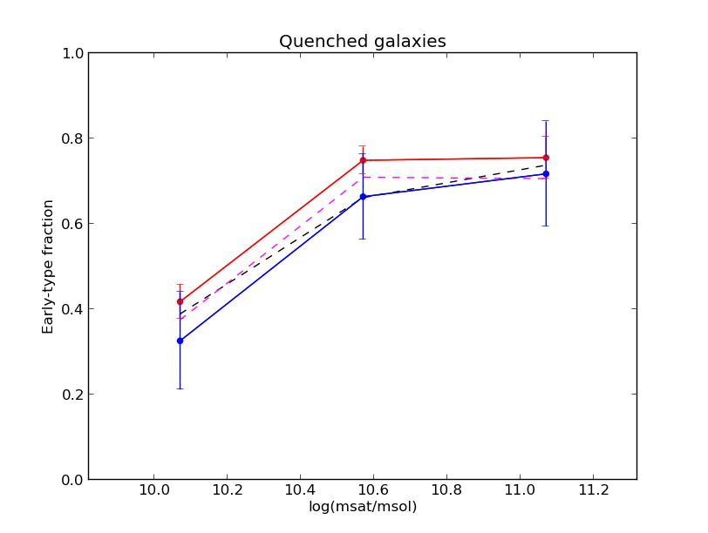
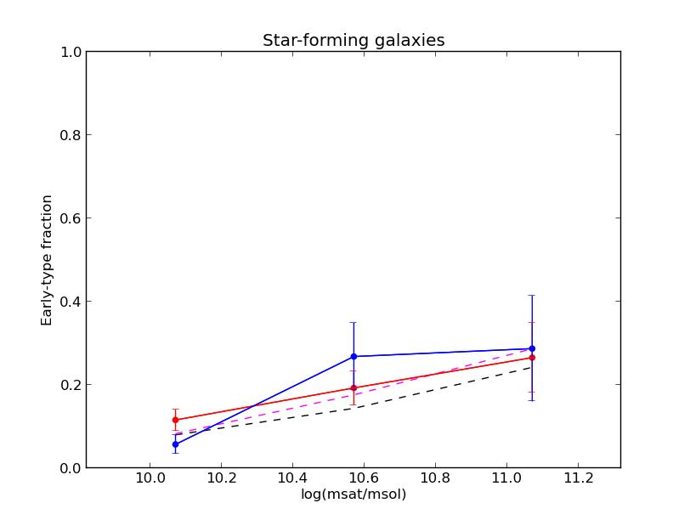
Conformity at 0.1<z<0.4
Log(SSFR)
<ε_{sat}>
Early fraction
log(m*)
log(m*)
Kovač K.+, in prep.
No difference in the SSFR/morphological fractions for quenched and SF galaxies in the groups with different types of central

Slide 12
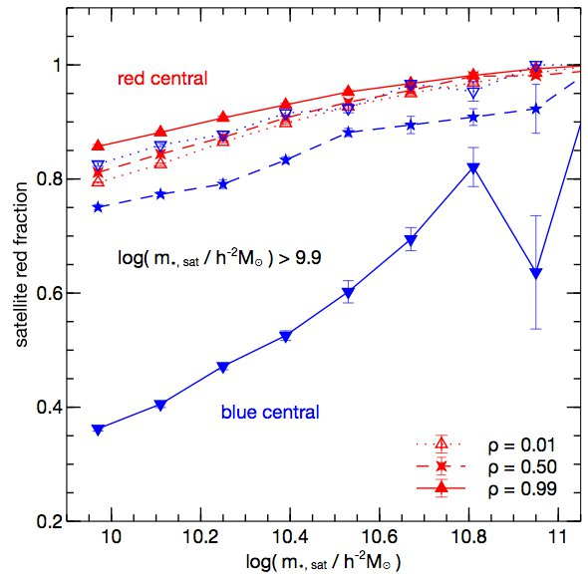
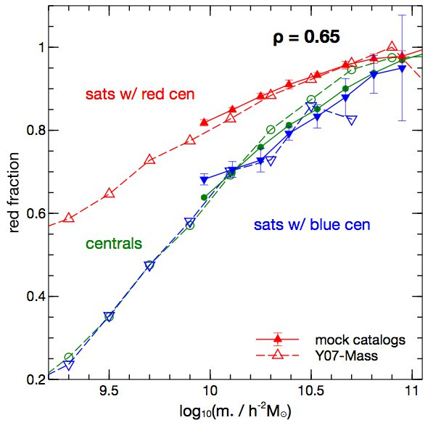
A Tunable Halo Model of Galactic Conformity
p(red|s) = (1 - ρ) p(red) + ρ Θ(s – s_{red})
Correlation between the galaxy colour and the concentration of a parent halo can explain the conformity-like effects.
Mocks with ρ = 0.65 closely resemble the SDSS results.
Paranjape, Kovač, Hartley, Pahwa 2015

Slide 13
Conclusions
1) Red fraction in 0<z<0.7 appears to be separable in mass and environment, suggesting the existence of the two independent quenching mechanisms: mass quenching and environmental quenching
2) Red fraction of satellites requires additional quenching mechanism in addition to the mass quenching: at the same mass and overdensity, satellites are redder; satellite quenching efficiency can explain majority of the overall environmental effects at least up to z=0.7
3) Satellites of quenched centrals are few times more likely to be quenched than satellites of star-forming centrals, indicating the existence of some “hidden variable” shared by the centrals and satellites in the same group
4) Our modified HOD framework which correlates galaxy colours with the concentration of the parent halo, can explain conformity-like-effects; it makes the older, more concentrated haloes at fixed mass preferentially host quenched galaxies
R.A.
Dec

