Slide 1
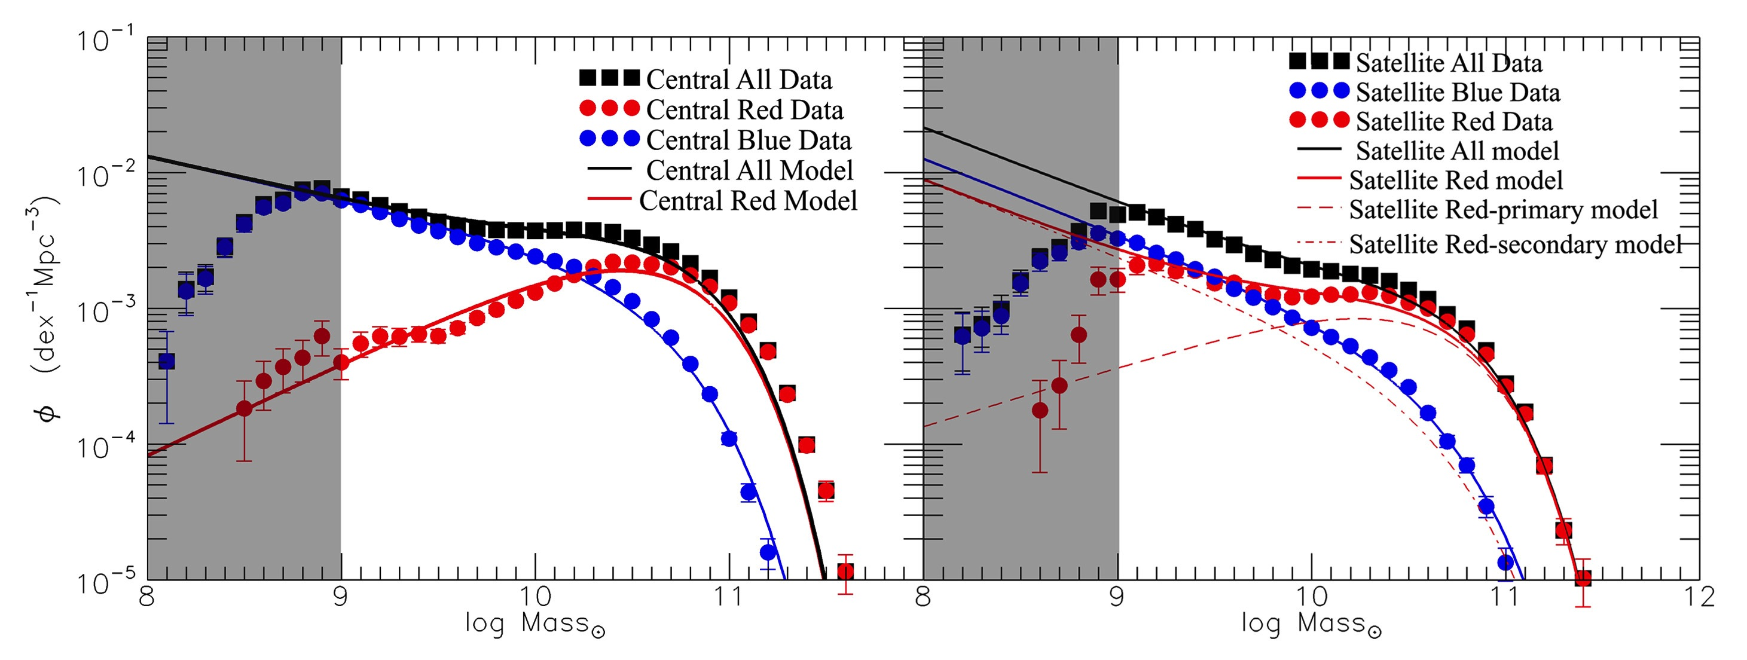
Mass and environment quenching (Peng et al 2010, 2012)
Two “separable effects”
Mass-quenching: Depends on mass but not environment
Satellite quenching: Depends on environment but not on mass
centrals
satellites
from Peng et al (2012)
But are they actually the same thing?
NB ε_{sat} measures the differential effect of the environment on top of effect of mass (or vice versa).

Slide 2
Revisit of environment effects in SDSS (Knobel et al 2014)
Variation of ε_{sat} in 1-d in m_{sat}, m_{h}, m_{cen}, δ, R and sSFR_{cen}
Essential to control in halo mass. Conformity in satellites that are carefully matched in all five of m_{star}, m_{halo}, δ, R, m_{cen}
Bottom line: Environmental quenching effects as measured by ε_{sat} are 2.5 times stronger in satellites with quenched centrals than those of SF centrals after taking into account all other effects
“conformity” (Weinmann+ 2006)

Slide 3
Galaxies as (not) probabilistic systems
Observed fraction of systems quenched
“probability of quenching”
Galaxies are (probably) not probabilistic systems. The apparent probabilistic aspect of quenching reflects incomplete knowledge, i.e. the presence of “hidden variables”.
Conformity implies that there must be a “hidden common variable” that is playing an important role in linking the quenching of centrals and environmental effects in satellites.
Environmental-quenching (largely) caused by halo-wide effects consequent to mass-quenching of the central by whatever mechanism.
Both mass- and environment-quenching are both caused by halo-wide effects shared by centrals and satellites of a given halo (incl. formation history of halo)

Slide 4
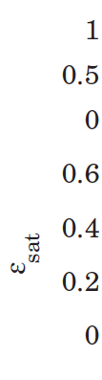
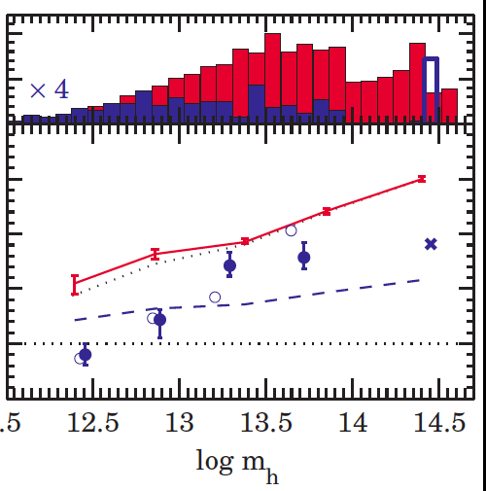
Another argument in favour:
Environment-quenching of (reasonably massive) satellites starts to be important at 11.5 < log m_{h} < 12.5. This is the halo mass (of centrals) that is associated with the Schechter stellar M* that is associated with mass-quenching.
Also: independence of structure on whether mass- or environment- quenched (Carollo et al 2014)

Slide 5
m_{halo}
But then why do satellite-quenching and mass-quenching have such different dependencies on galaxy mass?
δ
Expected!!
Distribution of most environment variables for satellites is independent of the satellite’s mass!
But note this requires quenching “response” to be independent of satellite mass.
m_{cen}
r/r_{rms}

