Slide 1
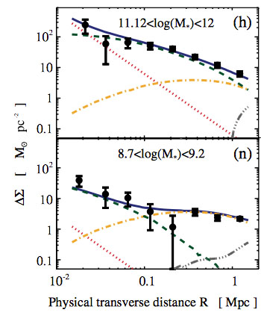
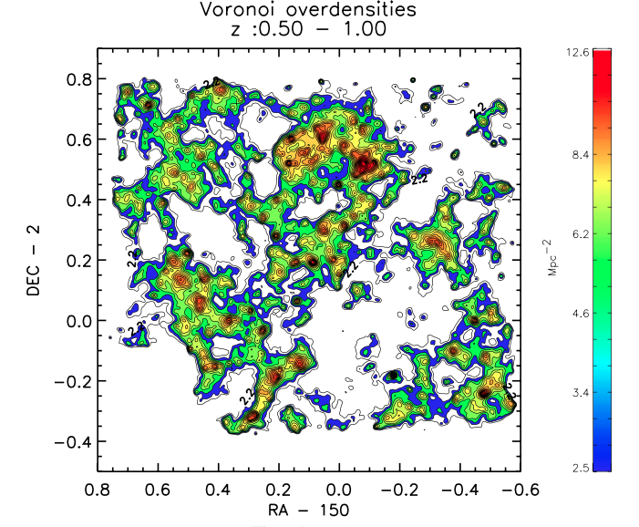
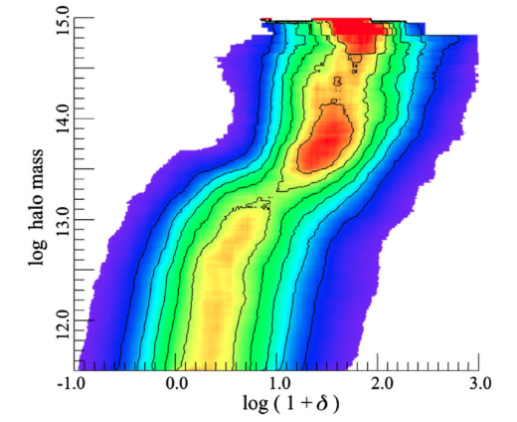
What is environment anyway?
Galaxies?
Dark matter?
Both?
Baryons
Host Dark Matter
Satellite Dark Matter
Mostly Quenched
Scoville et al. 2013
Mostly Star Forming
Peng et al. 2013
Leauthaud et al. 2012

Slide 2
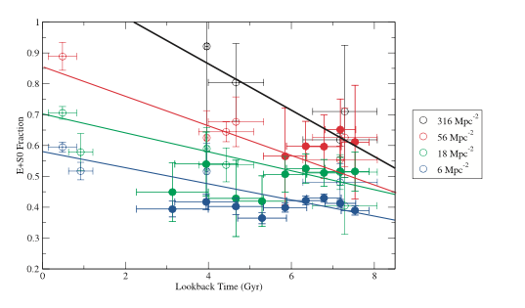
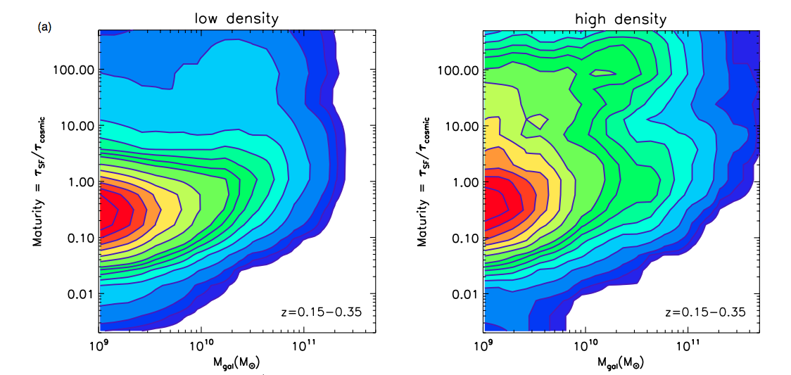
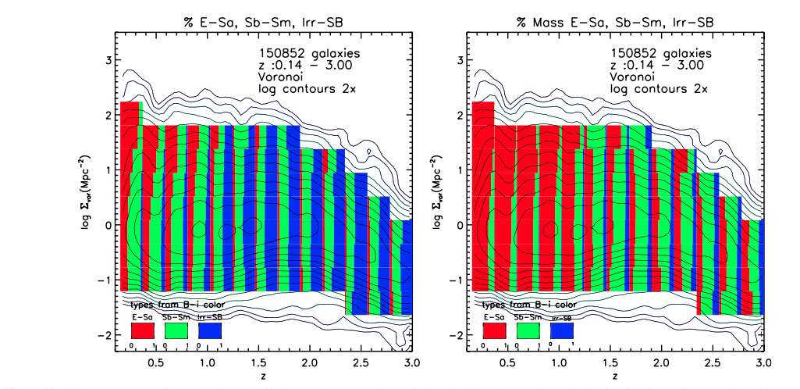
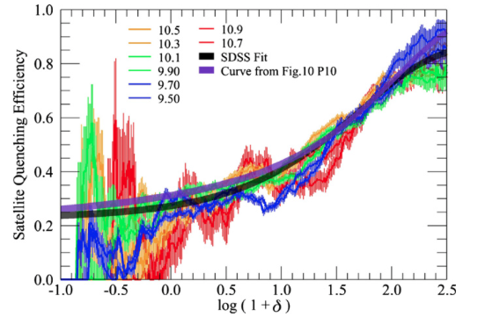
Does density (of galaxies) matter?
Morphology evolves more rapidly in dense environments (Capak et al. 2007)
SFR decreases with density, galaxies get older
(Scoville et al. 2013)
E+S0 fraction
Maturity
Lookback time (Gyr)
Mass
Mass
Environment matters most for satellites (Peng et. al. 2012)
Log(Density)
Quenching Efficiency
Redshift
Density

Slide 3
Is quenching entirely (dark matter) environment?

Slide 4
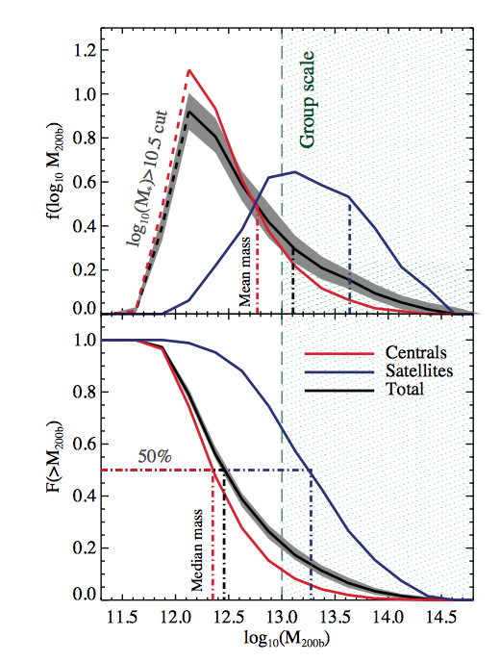
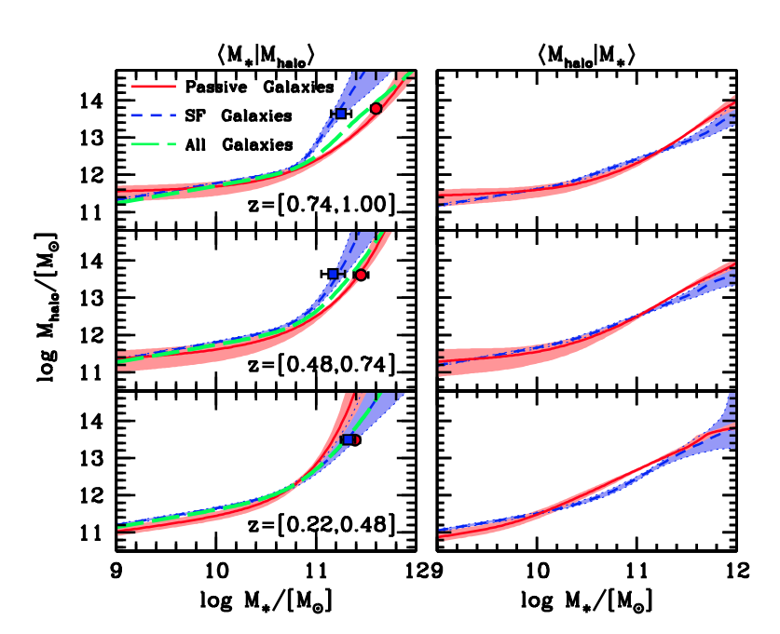
AGN and the growth of haloes
Where are the AGN?
(Leauthaud et al. 2015)
Halos keep growing
(Tinker et al. 2013)

Slide 5
